Slide 1


Dedicated to Professional Animal Care

Slide 2
Mission
The American Association of Zoo Keepers exists to advance excellence in the animal keeping profession, foster effective communication beneficial to animal care, support deserving conservation projects, and promote the preservation of our natural resources and animal life.

Slide 3
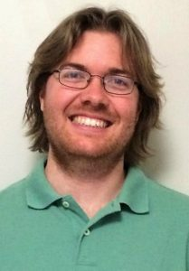
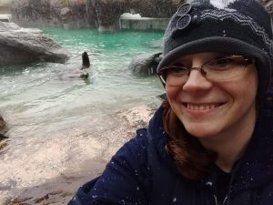
Board of Directors - Executive Board
Paul Brandenburger
President
Areas of Responsibility:
Education, Recognition and Communications Teams
AAZK Board Management
Nicole Pepo
Vice President and Ethics Chair
Areas of Responsibility:
Conservation and Regulation Teams
Liaison Management
Conservation Partner Management
Notes:
Like any organization, AAZK has a system of governance that is made up of the Board of Directors, CEO/CFO, Director of Professional Development and Publications editor.
The Board of Directors consists of 7 members that maintain the organization as a leader in the fields of animal care and conservation.
The mission of the board is to provide leadership for the AAZK Committees and Programs and the membership by operating in accordance with the overall mission of AAZK.
Our current board members were sworn in to their positions at the 2019 AAZK Conference in Indianapolis, IN. Executive officers serve a 2 year term and shall serve no more than two consecutive terms.
Directors on the board are elected into 4 year terms and can serve no more than two consecutive terms.

Slide 4
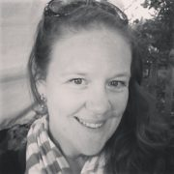
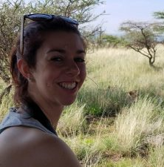
Board of Directors
Ellen Vossekuil
Education Team Oversight
International Outreach Committee (IOC)
AAZK Resource Committee (ARC)
Sara Bjerklie
Conservation Team Oversight
Conservation Team
Bowling For Rhinos (BFR) Program
Trees For You and Me (TFYM) Program

Slide 5
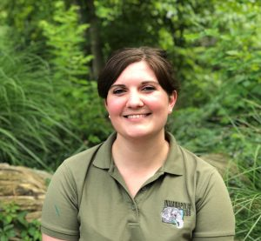
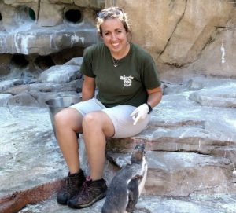
Board of Directors
Abbie Doan
Communications Team Oversight
Communication Committee (Comm2)
National Zoo Keeper Week Program (NZKW)
Kristen Scaglione
Regulation Team Oversight
Bylaws
Animal Welfare Committee
Safety Committee

Slide 6
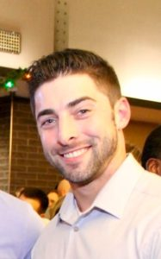
Board of Directors
James Weinpress
Recognition Team Oversight
Grants Committee
Awards Committee

Slide 7
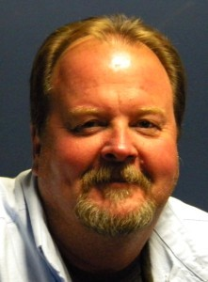
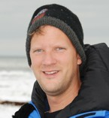
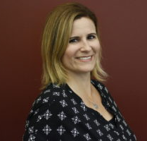
AAZK Staff
Ed Hansen
CEO / CFO
Shane Good
Animal Keeper Forums’ Editor
Bethany Bingham
Director of Professional Development and Conference Management
Notes:
CEO/CFO
Responsible for day-to-day operations and financial management
Editor/Graphics Editor
Publication of the Animal Keepers’ Forum and other AAZK publications
Director of Professional Development and Conference Management
New position as of 2019
Development of resources and program management of AAZK Conferences

Slide 8
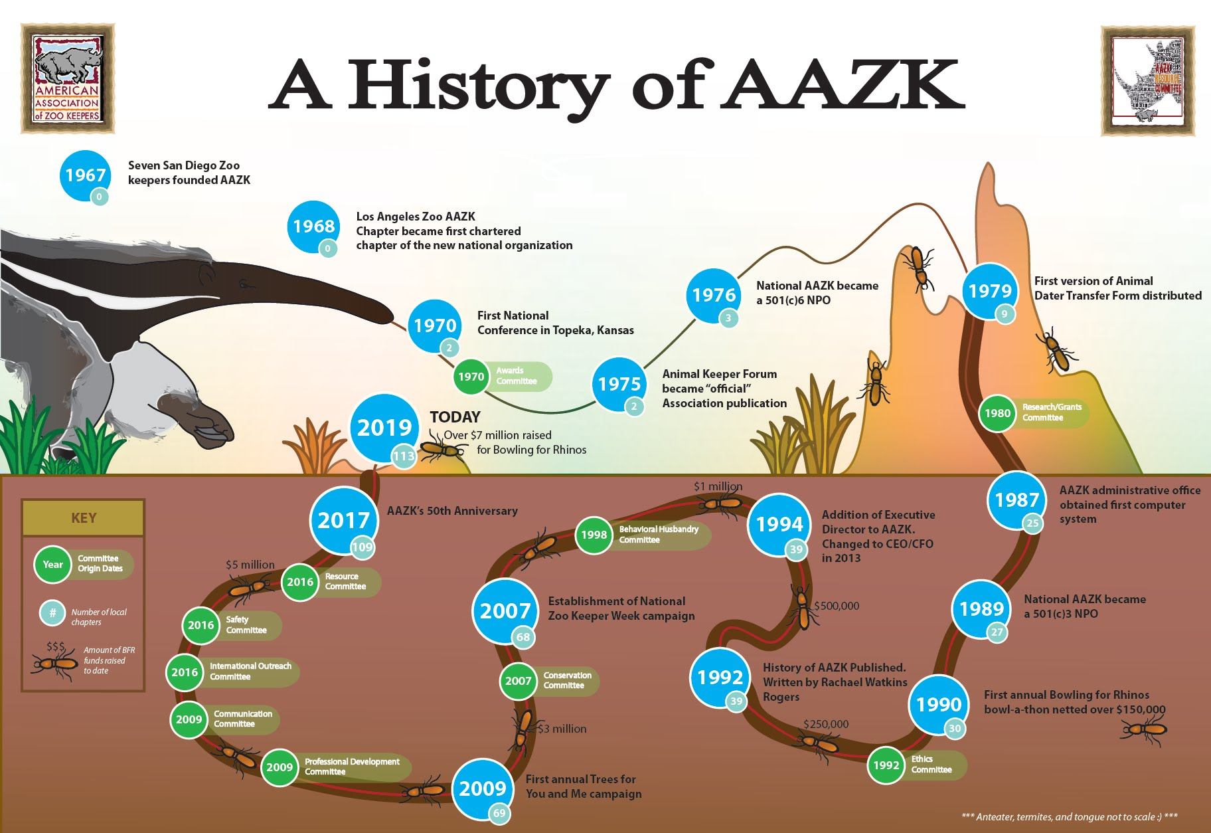
Notes:
This infographic was created by the AAZK Resource Committee in 2018 as a quick reference into the history of AAZK.
Resources like this continue to be created to and updated as information is added or modified.

Slide 9

Vision
AAZK will be the leader in the zoo and aquarium industry fostering professional development and personal connections that advance animal care, animal welfare and conservation.

Slide 10








AAZK Committees
Ethics
Notes:
To fulfil the vision of the organization, AAZK seeks to cultivate quality animal care by making the latest techniques and resources available in the categories of animal husbandry and management. By also recognizing the efforts of groups and individuals for excellence in advancing the animal keeping profession and promoting conservation efforts, AAZK committees and programs further the vision of the association.

Slide 11
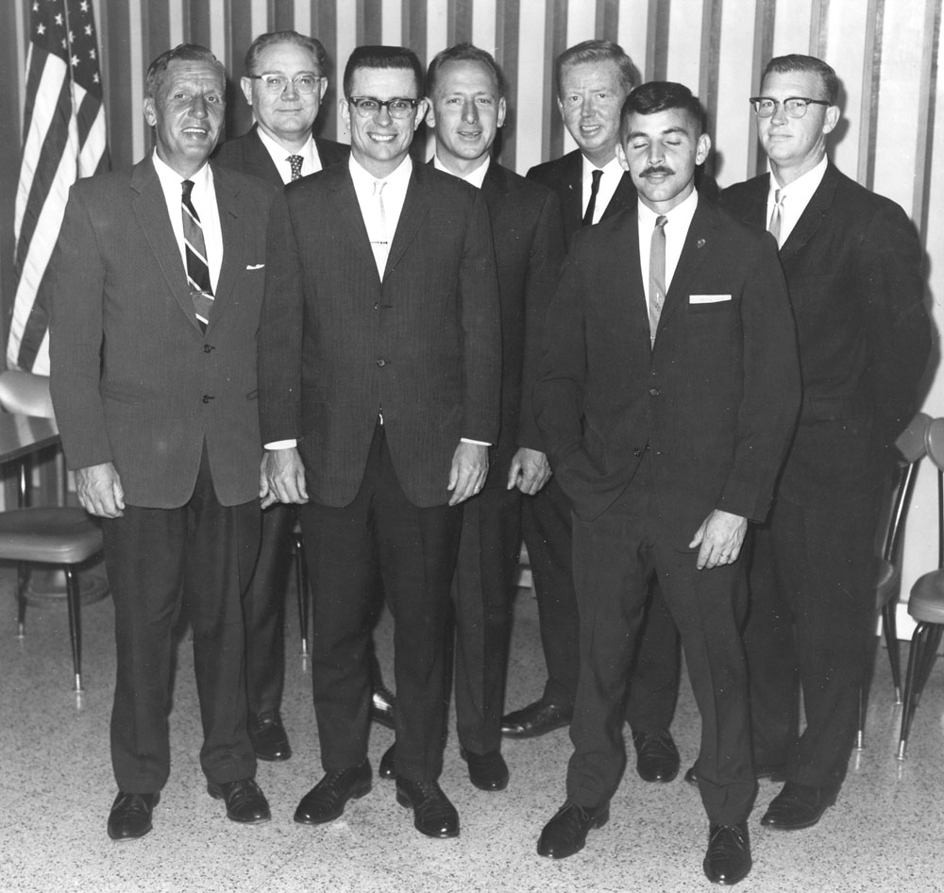
Purpose of AAZK
Foster a professional attitude in animal keepers by
  encouraging them to become active members of the professional teams at today’s zoos and aquariums
  supporting the promotion and implementation of animal keeper education
  striving to make general public aware of concern for conservation and preservation of our natural resources and animal life.
Founding 7 members of AAZK
Notes:
AAZK began in 1967 by 7 animal keepers in San Diego, CA with the purpose of promoting professionalism in zoo keeping.
AAZK is a US Federal Non-profit organization 501©3 of dedicated animal care professionals and people interested in promoting quality animal care in the zoo and aquarium professions.

Slide 12



AAZK Programs
Bylaws
Notes:
AAZK Programs play a vital part in the purpose of AAZK. They provide unique ways for animal keepers in helping the general public become aware of concerns for conservation and preservation of our natural resources and animal life.
NZKW - 2007 (became its own program in 2018)
TFYM - 2009
BFR - 1990

Slide 13
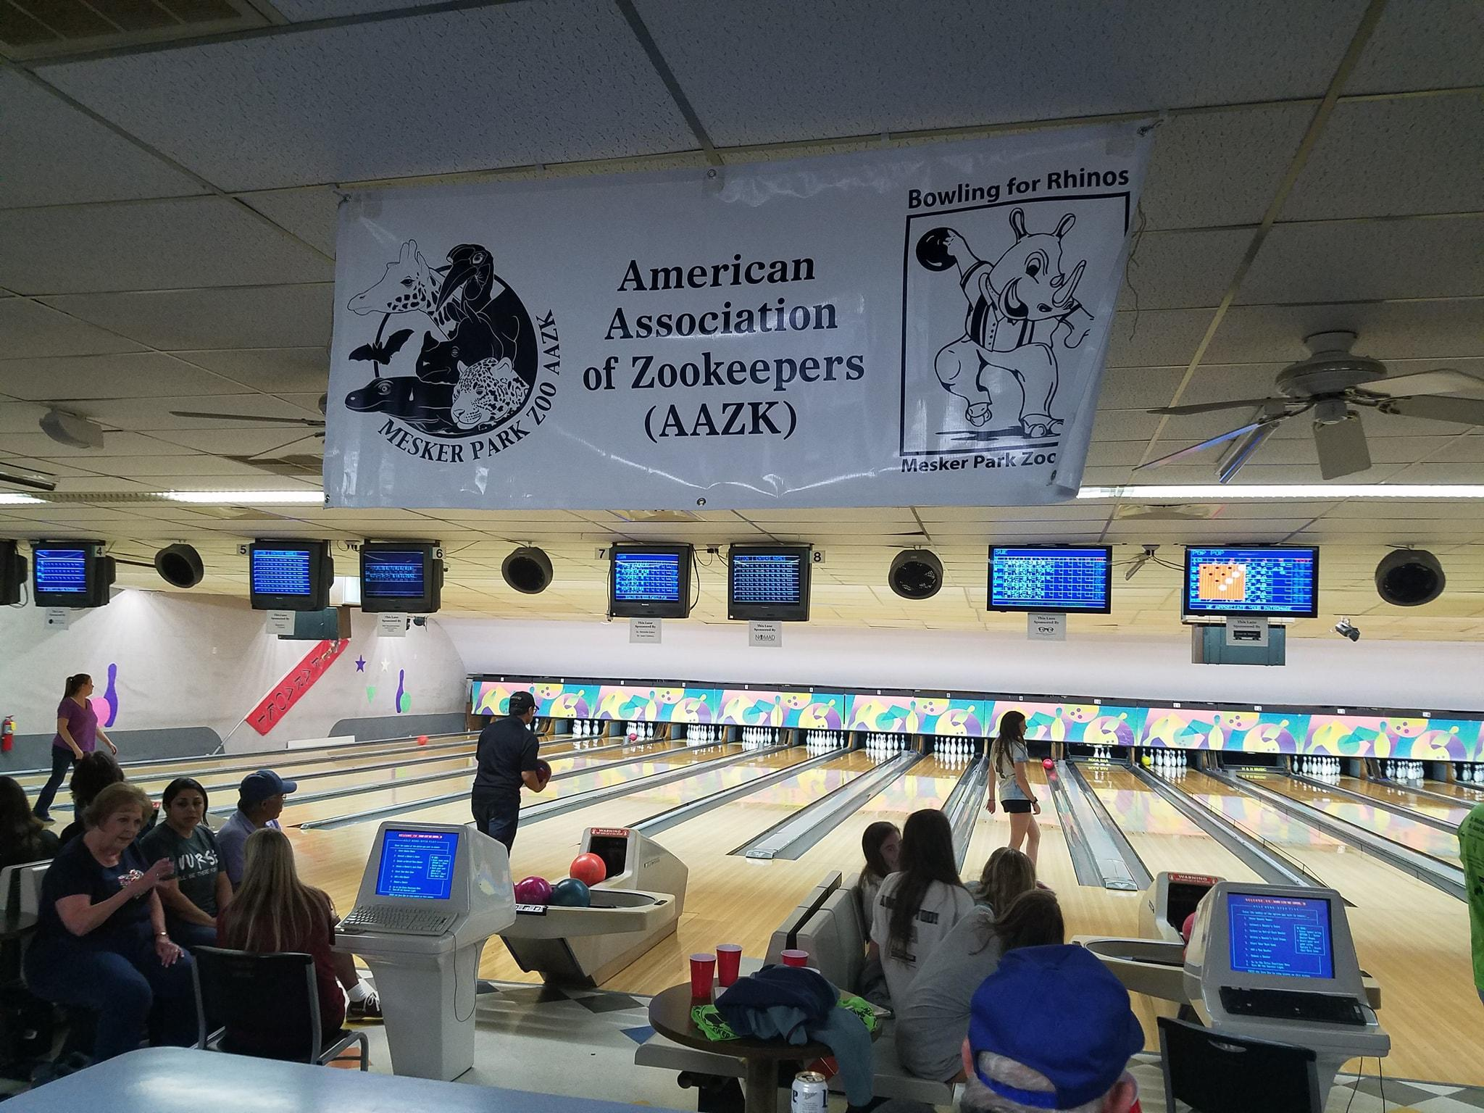

AAZK Bowling For Rhinos -- BFR
Connects dedicated individuals with conservation organizations working directly with rhino and their habitats.
Provides an avenue for raising funds and awareness to support in situ programs focused on education, protection, population management, and habitat conservation.
visit the AAZK website for more information
Notes:
Bowling for rhinos is an event unique to AAZK. Started in 1990, Bowling for Rhinos is a worldwide bowling-type events that raises money for in situ rhino conservation.
Created because keepers wanted to help save rhinos and the ecosystems
Today approximately 85 chapters in the US and Canada participate in a Bowling For Rhinos event.
These events have raised over $8 million dollars and counting for habitat preservation, rhino conservation in Africa and Asia

Slide 14
AAZK Trees for You and Me -- TFYM
Educates individuals about climate issues
Encourages fundraising by AAZK Chapters
Funds a forest-based carbon-offset grant to qualified entities in an effort to help polar bears and the loss of their sea ice habitat.

Slide 15
National Zoo Keeper Week -- NZKW
Promote and raise awareness for animal care profession
Educate the public about what animal care professionals do year round.
Provide members with tools to recognize peers and promote the profession

Slide 16
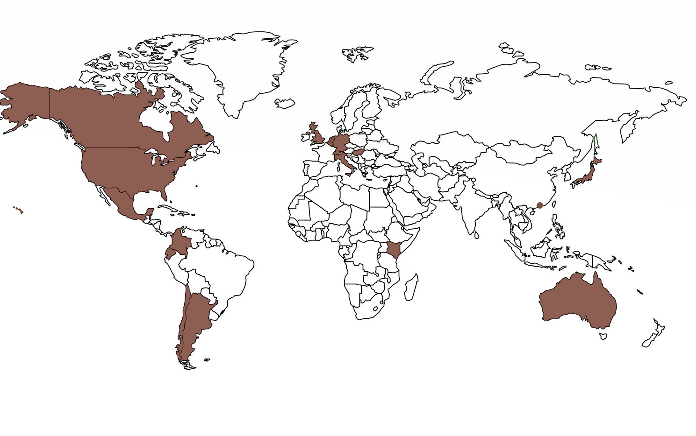
Where In the World are We?
Membership is 2,200 strong
Representing 195 animal facilities
  including public and private zoos
  aquariums
  accredited animal sanctuaries
Membership represents in 50 US states, 6 Canadian provinces, and 18 foreign countries
Notes:
Statement from AAZK of animal keepers on Racial Equality (June 6, 2020)
As animal keepers, we are granted the ability to engage with millions of Americans each year on topics such as environmental conservation, the preservation of natural resources, and animal biodiversity. Minorities and their communities across the globe continue to lawfully assemble and demonstrate in opposition to systemic racial inequalities and violence, and we stand by them. We recognize that people of color are underrepresented in our profession and we must work on acknowledging, listening to, and learning about community concerns at this time. Diversity in the association and the field is integral to a successful workforce, and we recognize the work that needs to be done to serve all in our membership. Today’s keepers are tomorrow’s hiring managers and AAZK hopes that our membership boosts the inclusion of minority interest, understanding, and presence in the animal care profession.

Slide 17
AAZK Chapters
116 chartered chapters of AAZK
Provide professional development opportunities for members by hosting
  workshops
  lectures
  training sessions
  enrichment brainstorming sessions
  travel opportunities for national and international conferences and workshops
On average, chapters raise in total of $800,000 per year for local, regional and international conservation efforts
Notes:
AAZK is not just individual members all over. AAZK chapters are formed in affiliation with a zoological facility (zoo, aquarium, sanctuary, etc.)
Each chapter is chartered with AAZK and adapts the AAZK constitution for governing.
Chapters consist of dedicated members sharing the mission and working on the purpose of AAZK.

Slide 18
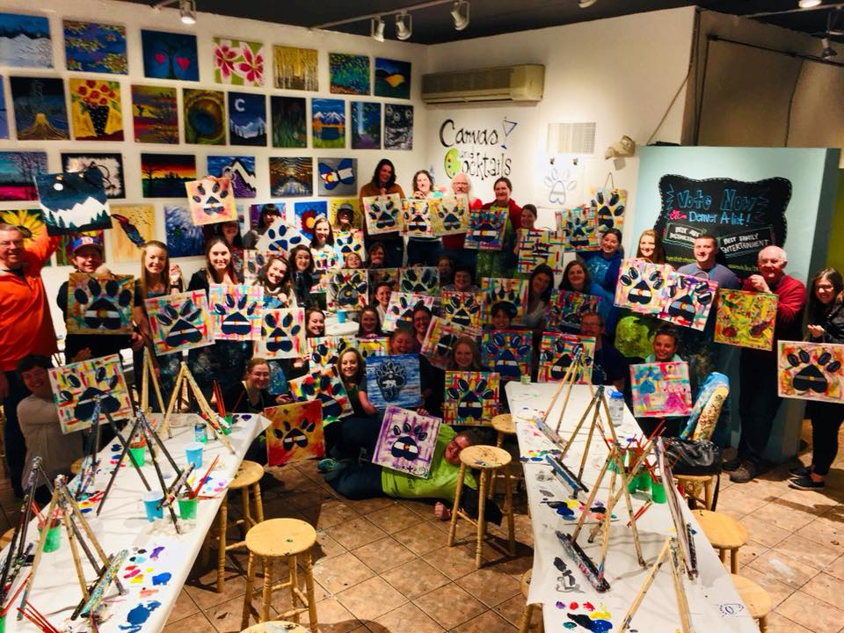
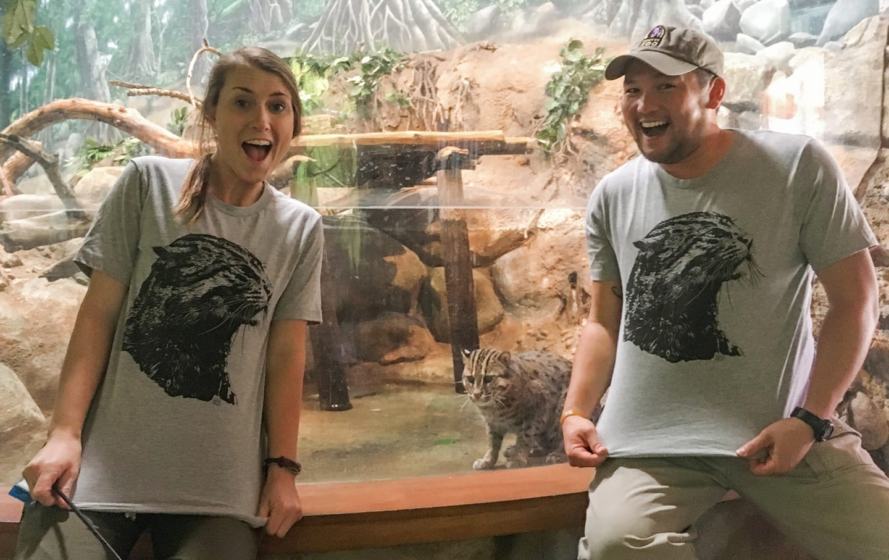

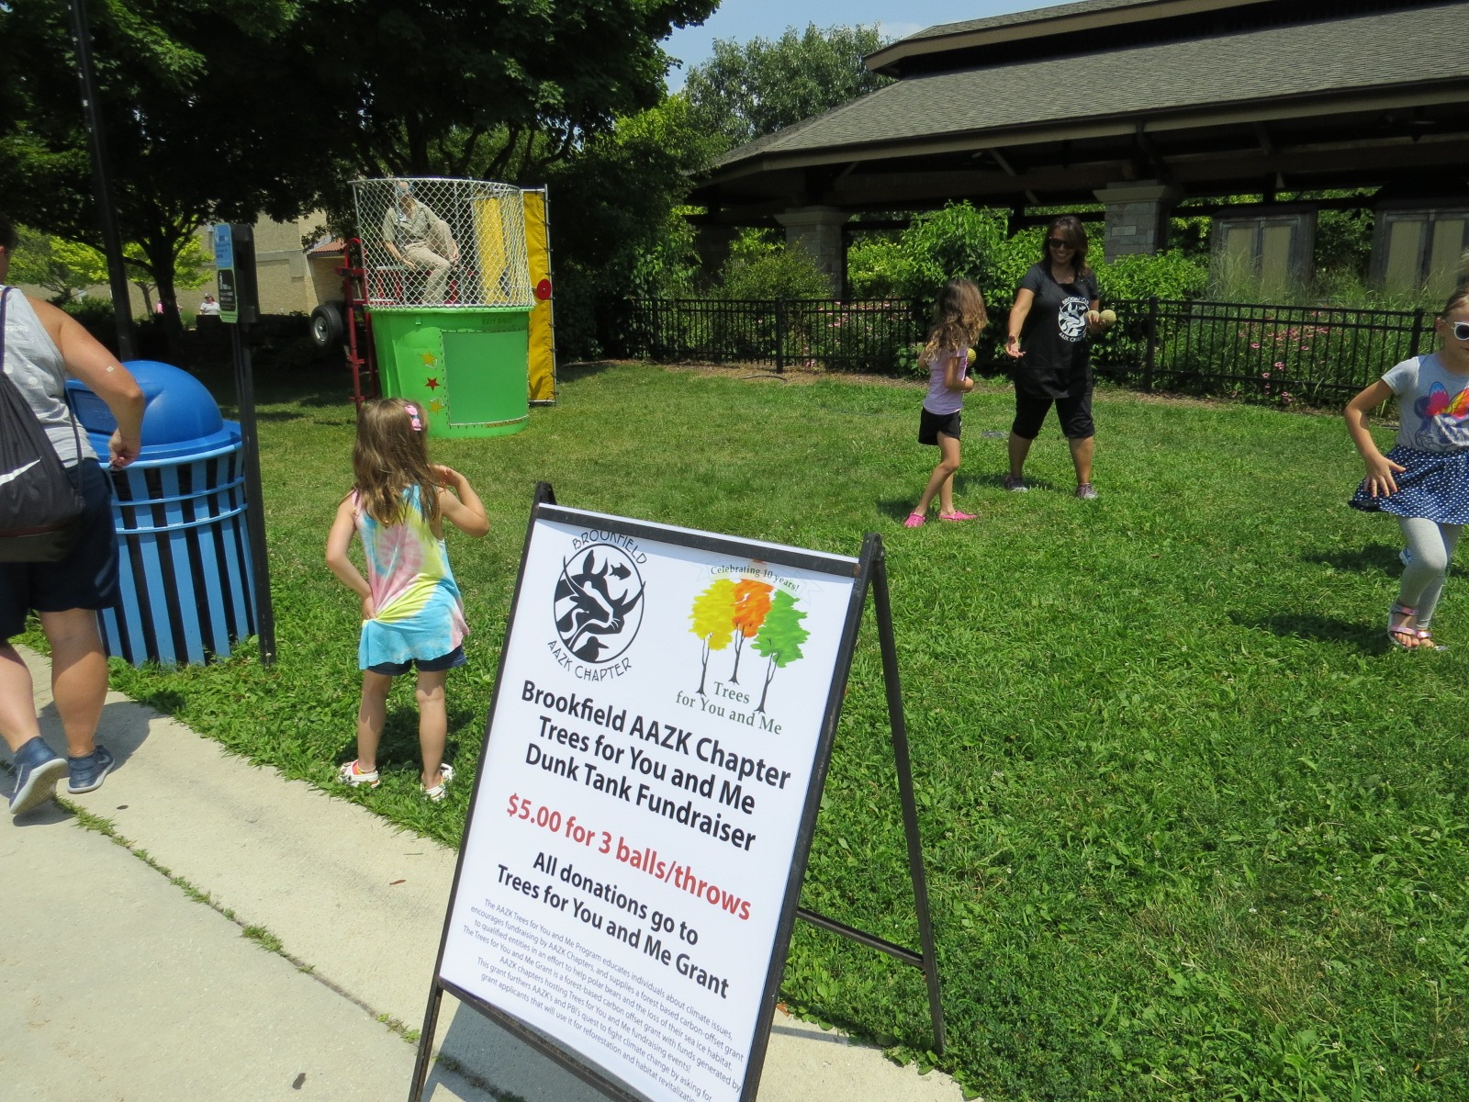

Painting for Polar Bears
Fundraising for Fishing Cat Fund
Climbing for Clouds

Slide 19
Chapter Name (insert chapter logo)
Give brief overview of your Chapter
Examples of items to include:
Chapter Mission
Year Started
Facilities associated with Chapter
Current number of members
Notes:
CUSTOMIZE this slide:
use the column on the right for your chapter contact information and/or to advertise your next event.

Slide 20
Chapter Name (insert chapter logo)
Chapter Officers (introduce each chapter officer, add contact info, area of responsibilities, and pictures if possible)
President
Vice-President
Secretary
Treasurer
Notes:
CUSTOMIZE this slide:
use the column on the right for your chapter contact information and/or to advertise your next event.

Slide 21
Chapter Name (insert logo as well)
Give brief overview of opportunities provided in your chapter
Examples to include are:
Professional development opportunities or funds
Networking & leadership opportunities
Chapter conservation fundraisers
Include information on how to become a Chapter member!
Notes:
CUSTOMIZE this slide:
use the column on the right for your chapter contact information and/or to advertise your next event.

Slide 22
Is AAZK just for animal keepers?
NO
Although AAZK membership is fundamentally comprised of animal keepers, AAZK membership is open to interested individuals, facilities and conservation groups.
Animal keepers could not accomplish everything that they do without the help of many. From volunteers, curators, facilities, conservation partners, interns, seasonal, education, veterinary staff, etc.,
AAZK welcomes ALL!
Notes:
There are so many great opportunities to share the AAZK mission, vision and purpose but why does this matter to me if I’m not a animal keeper?
That’s simple! AAZK is NOT just for full time animal keepers!

Slide 23
Individual Membership
Professional
Permanent full and part-time animal keepers, aquarists, veterinary technicians, or animal trainers directly involved with the care and feeding of captive wildlife in any recognized zoological park, aquarium, preserve or animal care facility
Affiliate
Personnel affiliated with an animal care facility with duties outside the realm of direct animal contact such as management personnel, volunteers, seasonal staff, docents and non-keeper positions
Student
Person interested in the animal care profession who is currently registered as a student in university, high school or middle school level
International
Personnel outside the US and Canada regardless of category
AAZK Membership
Notes:
In addition, there are also facility memberships. For more information, visit https://aazk.org/membership-account/membership-levels/

Slide 24
Individual Membership Benefits | Professional | Affiliate | Student
Animal Keepers Forum (AKF) subscription | x | x | x
Vote in AAZK Board of Directors Elections | x
Vote for AAZK Conference Host | x | x | x
AAZK Committee Opportunities | x | x
AAZK Grant Opportunities | x | x
Hold Office at the Board of Directors level | x
Hold Office at the Chapter level | x | x
Membership Rates for Conference | x | x | x
Membership Rates for Publications & Products | x | x | x
Gratis Membership to AAZK CORE | x
Discounted Membership Rate to AAZK CORE |  | x | x
Form Student Chapter |  |  | x
Hold Office at Student Chapter Level |  |  | x
Why Should I Become an AAZK member?
Notes:
There are many benefits for full time keepers (professional level) but take a look at the benefits for affiliates and students!

Slide 25
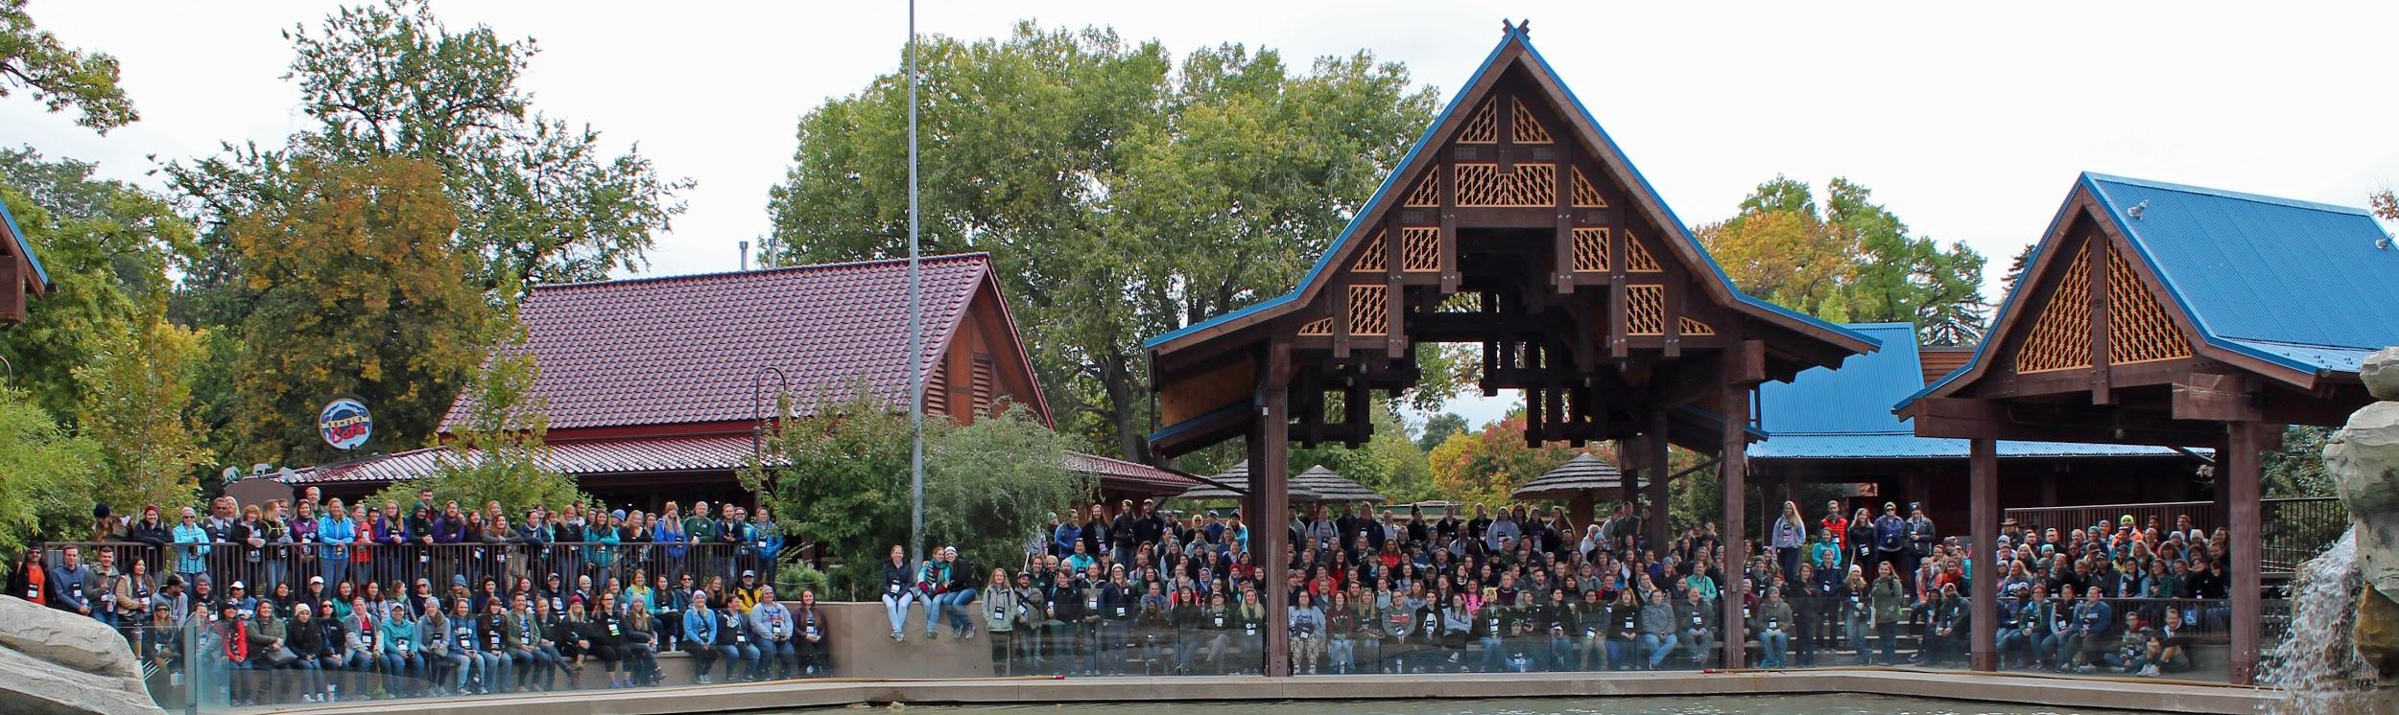
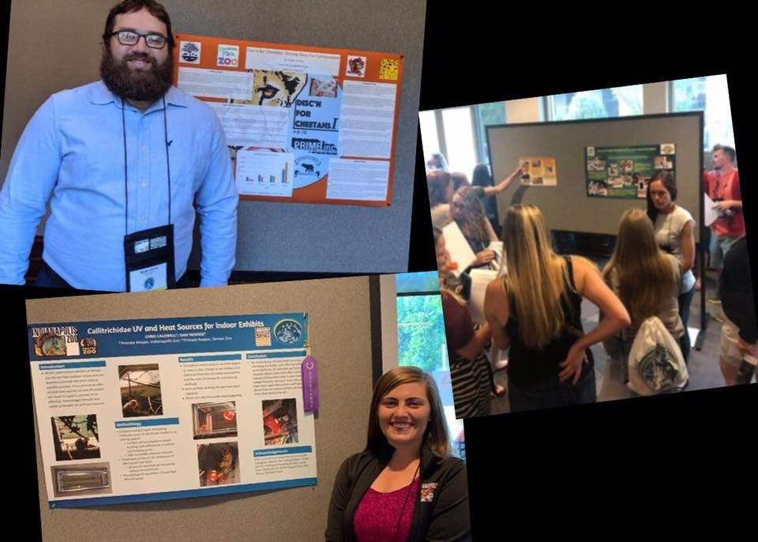
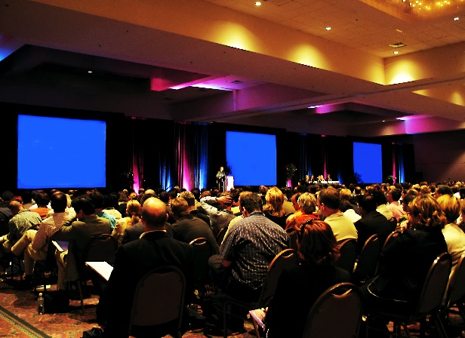
AAZK National Conferences
AAZK Affiliate
Conference Grant
Opportunities
approx. 300 attendees
Paper sessions
Topical Workshops
Professional Certificate Courses
Posters
Evening Social Programming
Zoo Day
Pre and Post Trips
Notes:
This conference provides a wonderful professional networking opportunity like none other.
With an average of 300 like minded individuals coming together to share their knowledge and skills of the zookeeping world.
Held annually in late summer/early fall
Hosted by an AAZK chapter with support from their host facility and AAZK
on click - AAZK Affiliate conference grant opportunities to attend a national conference.
Information is listed on the AAZK website under Grants committee in members only section

Slide 26


Future AAZK National Conferences
August 29th - September 3rd
2021
October 13th - October 17th
2022
Don’t forget your passport!
Notes:
Use this slide to to advertise future conference hosts.
All future conference hosts and dates are published on the AAZK website.
Videos about each upcoming conference can be found on the AAZK Facebook page for your enjoyment.

Slide 27


Future AAZK National Conferences
September
2023
Dates TBD
2024
Notes:
Use this slide to to advertise future conference hosts.
All future conference hosts and dates are published on the AAZK website.

Slide 28
AAZK CORE
Collaboration with San Diego Zoo Global Academy®, providing a large FREE course library to AAZK members
Additional DIY Certification courses provided by San Diego Global at your own pace and may have an additional cost associated with them
World class training opportunities
Available at ALL individual membership levels
Discounts for AAZK chapters and institutional members
Notes:
As an affiliate or student member, you get a DISCOUNTED membership to AAZK CORE (formally known as AAZK Online/AAZK Learn)
For more information about San Diego Zoo Global Academy courses, or to subscribe to the San Diego Zoo Global Academy Newsletter, please contact Bethany Bingham bethany.bingham@aazk.org

Slide 29

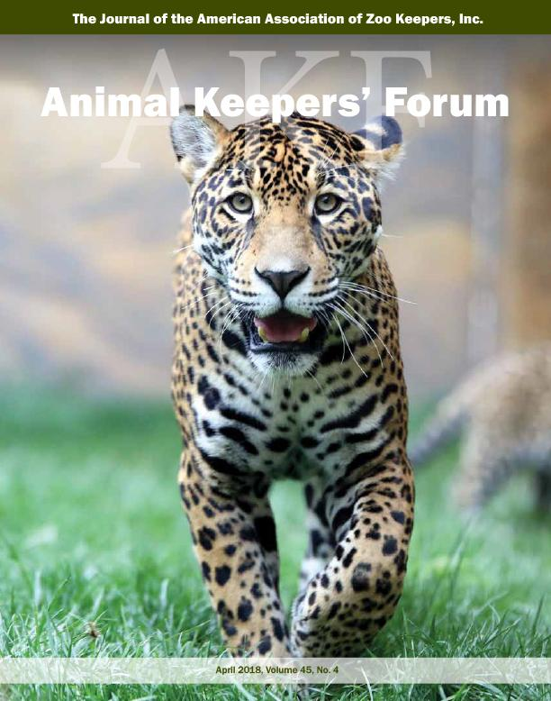
Animal Keepers’ Forum -- AKF
First issue was in 1972
Became the official monthly publication of AAZK in 1975
As of 2018, members have access to digital archives
Publications include
  organization updates
  upcoming events
  husbandry articles
  enrichment articles
  Training Tails
  Conservation Column
  Professional products and supplies
Notes:
AAZK media, AAZK conferences, and AAZK chapters are venues to exchange information in the fields of husbandry, environmental enrichment, behavioral training and conservation.
Through workshops, conferences, newsletters, and Internet forums, AAZK helps animal care staff stay current in the fields of husbandry, training, enrichment, nutrition, and conservation. Well- educated keepers using modern techniques means the animals in their care benefit tremendously. AAZK also provides networking and fundraising opportunities that support animal care, AAZK activities and conservation efforts.

Slide 30
Notes:
Affiliates members are HUGE part of AAZK! Whether you are a part time keeper, seasonal, volunteer, docent, curator, supervisor, assistant curator vet tech, vet, nutrition staff, maintenance, horticulture, education, guest services, etc. It Takes A Zoo!
Check out these AMAZING infographics that the National Zoo Keeper Week Program designed in 2020 to showcase how important you are to the mission, vision and purpose of AAZK and your facilities.

Slide 34



Student Membership
interns
zoo teens
explorers
volunteers
middle school
high school
college
Notes:
We all started somewhere, right? Our passion for animal care and conservation was probably cultivated through school, documentaries, conservationists, and visiting zoological facilities. Let’s continue to build that passion and commitment to this field. Encourage your (read word on slide) to join AAZK either with your chapter or on the national level.
Students can be members of any chapter, as per the chapters bylaws, and/or on a national level.
There are currently 3 chartered student chapters of AAZK

Slide 35
How Can You Be A Part of AAZK?
Sign up now at AAZK.org
Talk with members of your local AAZK chapter
Attend events hosted by your local AAZK chapter

