Slide 1
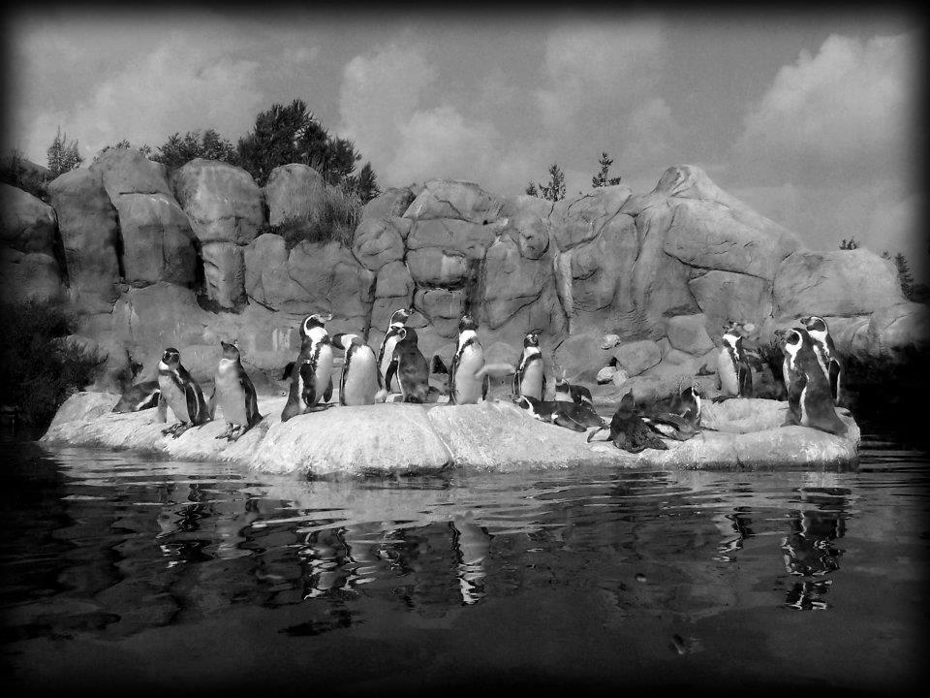
Humboldt Penguin Breeding Management at the Rosamond Gifford Zoo

Slide 2
Presenters:
Henry Fox, Director
Adrienne Whiteley, Collection Manager
Deborah Tobin, Penguin Keeper

Slide 3
Workshop Objectives
Describe strategies to create a successful breeding program
Highlight techniques for nest set –up
Describe theories behind fostering and highlight techniques to obtain egg data
Demonstrate egg candling and describe other incubation practices

Slide 4
Workshop Objectives
Discuss staff involvement during hatching process
Highlight post-hatch priorities and needs of parents
Discuss importance of monitoring chick development
Discuss all aspects of weaning chicks through their integration with colony
Highlight special cases and research opportunities

Slide 5
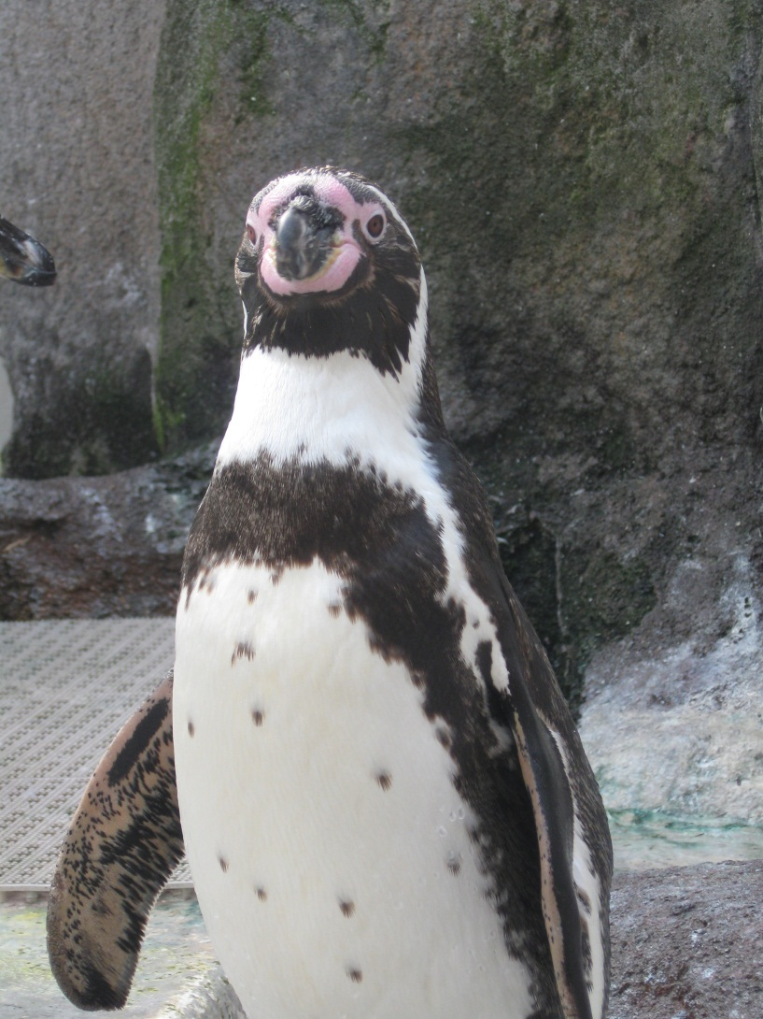
Welcome to Penguin Coast
Exhibit opened in June, 2005
Original colony of 19 birds from: Sea World San Diego, Portland OR, Brookfield IL, Philadelphia PA, and Columbus OH.
Staff advised that it may take up to 5 years for successful breeding

Slide 6
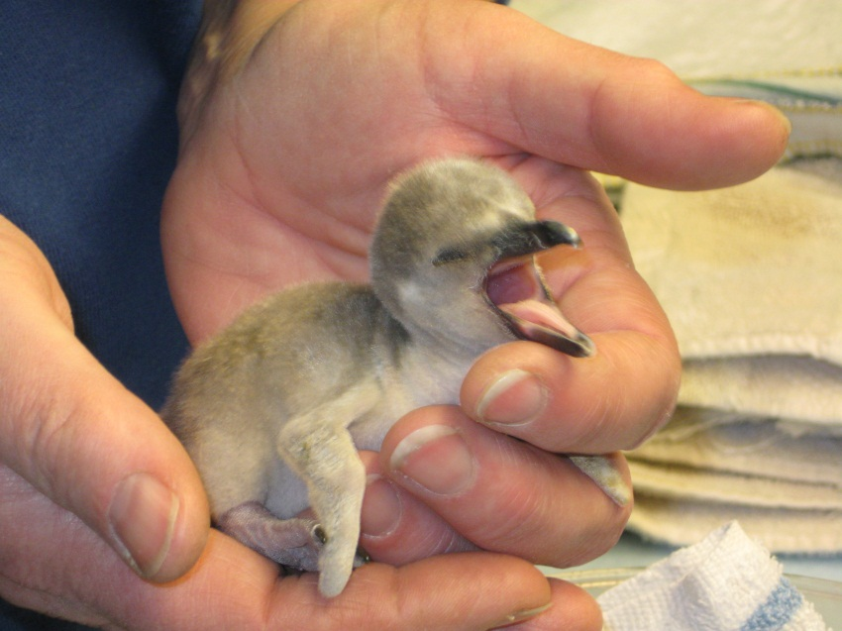
Breeding Management
Early Success

Slide 7
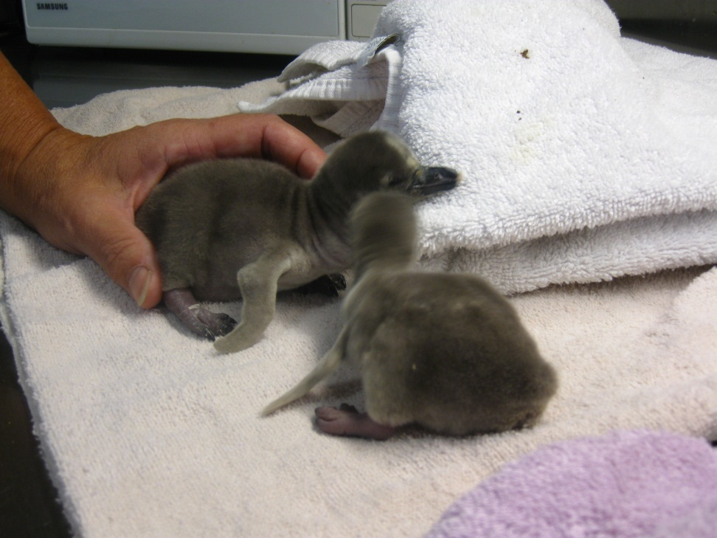
April 2006
Per SSP recommendations 4 penguins hatched at RGZ
All 4 successfully parent-reared until weaning

Slide 8
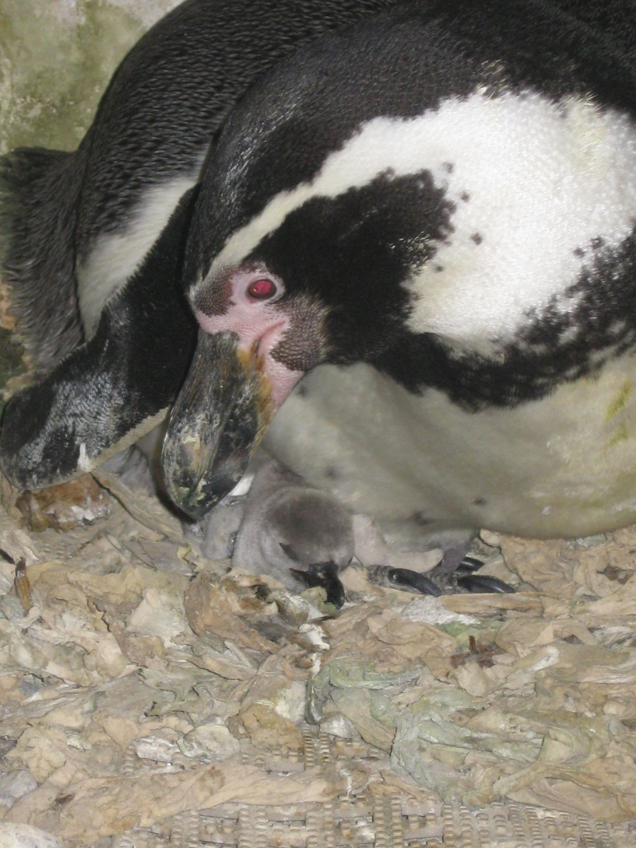
2006 - 2012
Per SSP recommendations RGZ has hatched 35 Humboldt penguin chicks
All 35 chicks were parent or foster reared

Slide 9
Strategies for success
Communication
Observation
Consistency

Slide 10
Communication
Correspondence between the Senior staff and SSP managers to establish a plan throughout the breeding season
Establish and post a “Breeding season protocol” for the area. Make sure all staff members adhere to it.

Slide 11
Observation
Observing & recording all breeding activity; this includes
copulation to nest building,
identifying potential conflicts; disputes over territory, and disagreements among existing pairs
allows staff to plan for potential foster pairs
Monitoring egg development and subsequent chick development, immediately addressing any concerns that arise

Slide 12
Consistency
Have a primary keeper for the area (limiting cross-training during breeding season)
Staff adjust their actions and routines and are able to work around the birds without disrupting them

Slide 13
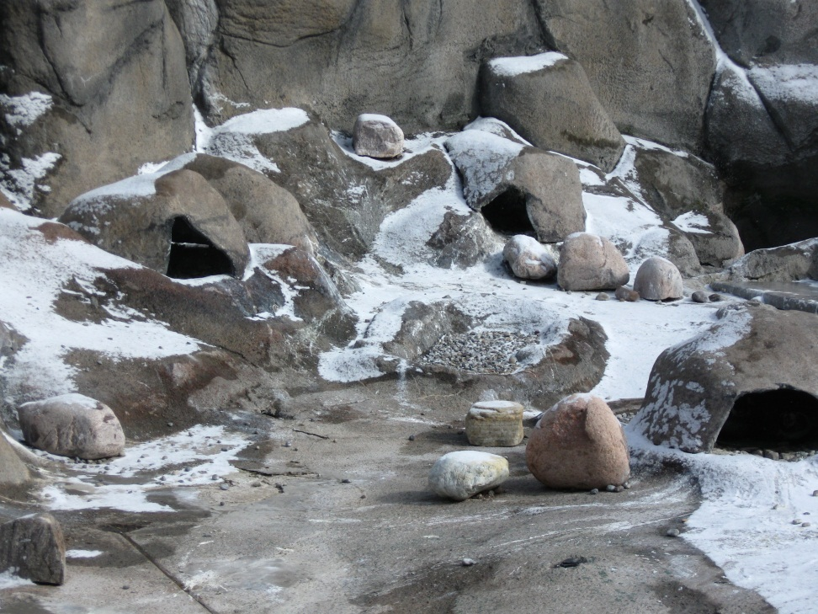
Nest set-up
Exhibit design allows birds the opportunity to establish a breeding site outdoors or indoors
Outdoor nest are accessible all year round. Nest crates are supplied indoors at onset of breeding season.

Slide 14
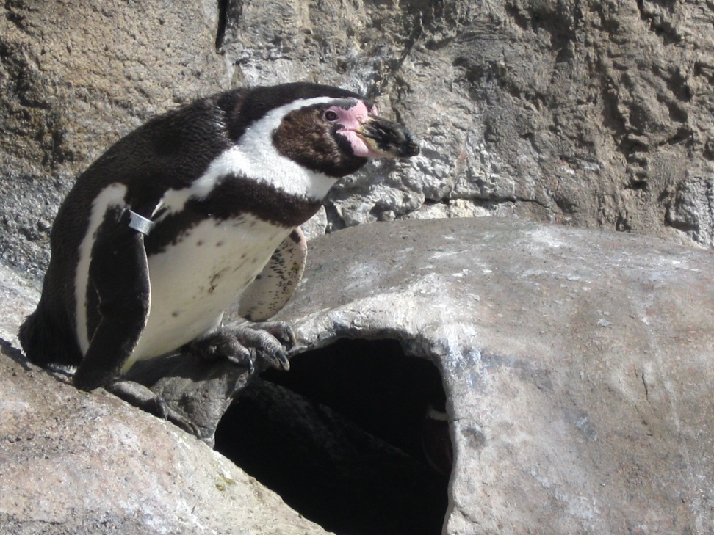
Outdoor Burrows
Burrows are spread out along exhibit to minimize disputes among males
Tops are removable and entire burrow can be cleaned when needed (usually mid-late summer)
Burrows are equipped with (2) drainage pipes
Rocks are supplied in the burrows
Several larger piles of rocks are available along the exhibit for the penguins to add to nests

Slide 15
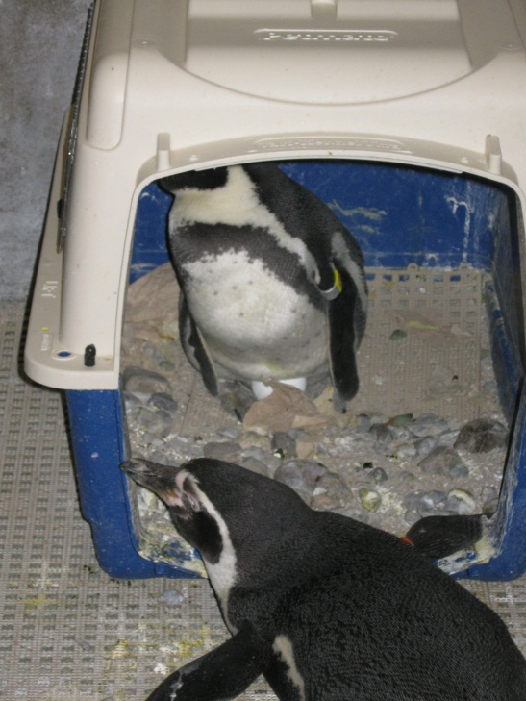
Indoor Burrows
Air kennels (size #200)
Equipped with Dri-deck® matting, clay cat litter, and rocks
Additional piles of rocks are placed in the room
Space kennels accordingly to minimize disputes among males

Slide 16
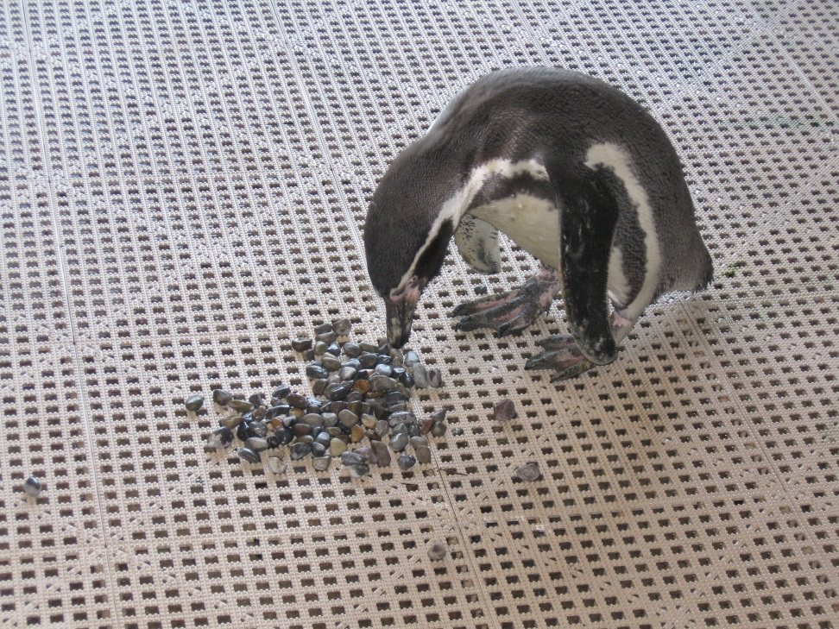
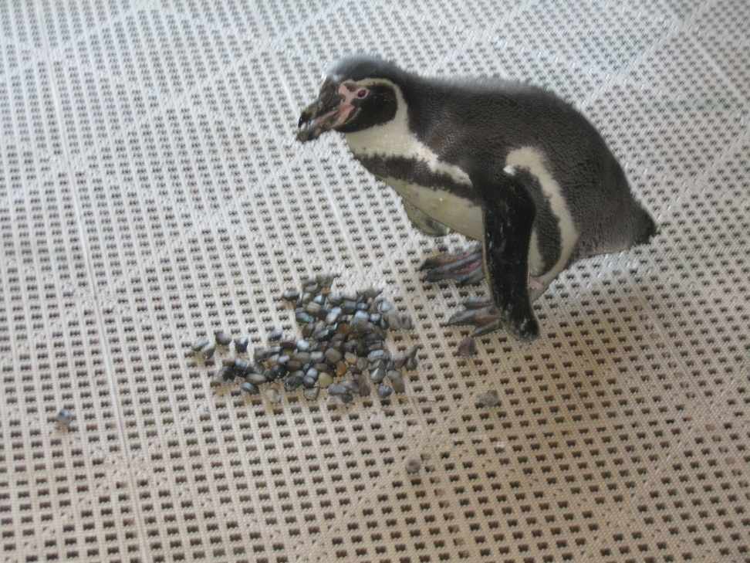
Indoor Burrows

Slide 17
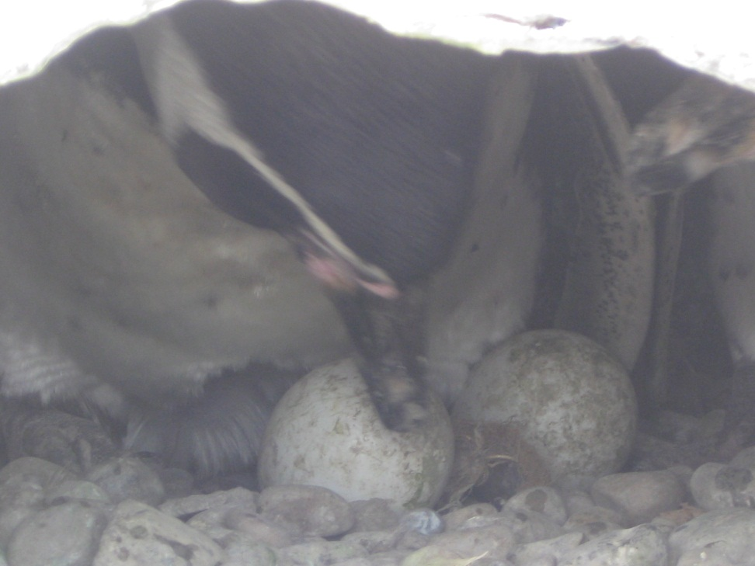
Egg Incubation and Data Collection
Staff at RGZ have made it a policy to obtain as much data as we can during incubation.
Monitor egg development throughout incubation (1st candling then optimally once per week until pipping)
Staff discussion on when to foster eggs/chicks

Slide 18
Considerations for fostering
Allows non-recommended SSP pairs to gain experience of incubation and raising chicks
Some pairs may be genetically valuable but behaviorally questionable in terms of parenting
Eases burden on pairs raising 2 chicks at once
Allows for early double-clutching in a breeding season

Slide 19
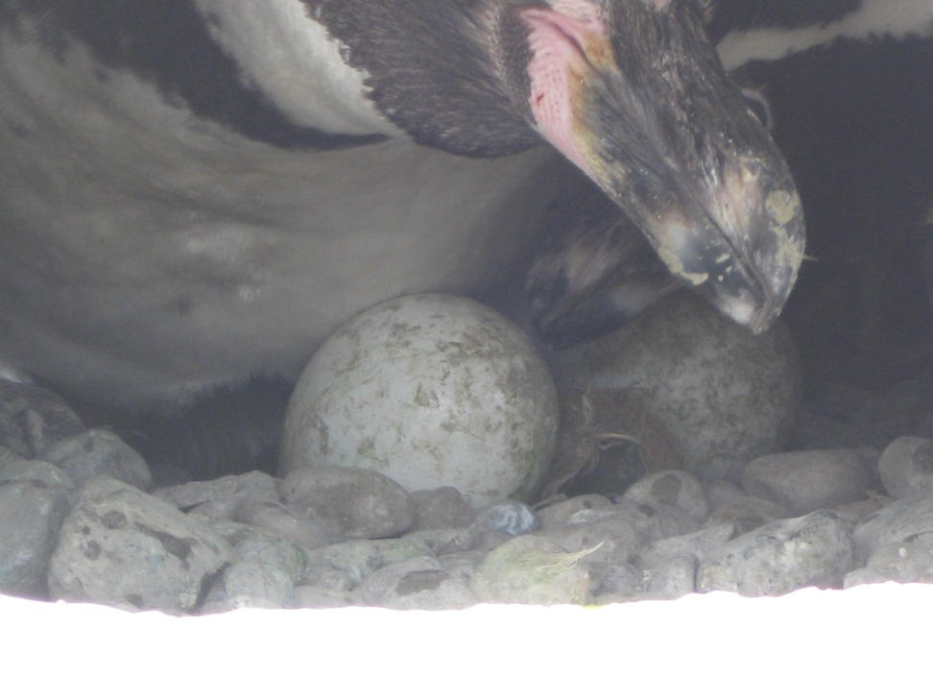
Techniques to obtain and check developing eggs
Ideally it is best to check egg development when only one parent is on the nest
Crate & burrow design and placement requires staff to access the eggs from the entrance of the nest
Using a large bath towel, staff can safely obtain the egg(s) by gently lifting up the bird that is incubating
Always keep egg covered in your hand, do not rotate while in the nest
Most pairs (especially inexperienced ones), receive a dummy egg while the natural egg is removed for candling

Slide 20
Candling
Staff should conduct 1st candling at day 7-10 of incubation
Recommend candling all eggs throughout the breeding season regardless of SSP recommendations . (Important to have fertility records for reference.)
Eggs should be weighed and checked thoroughly at each candling
Weekly candling allows staff to address any issues that arise (ie; improper weight loss of egg(s), too much weight loss, compromises of egg exterior)

Slide 21
Other considerations during incubation
Feeding nesting birds:
  Optimally staff does not feed birds in their nests
  Want to encourage parents switching off the nest equally,(limits one parent from staying on the nest too long, decreases displaced aggression of one bird towards another)
  Continue offering normal amounts of fish to all birds

Slide 22
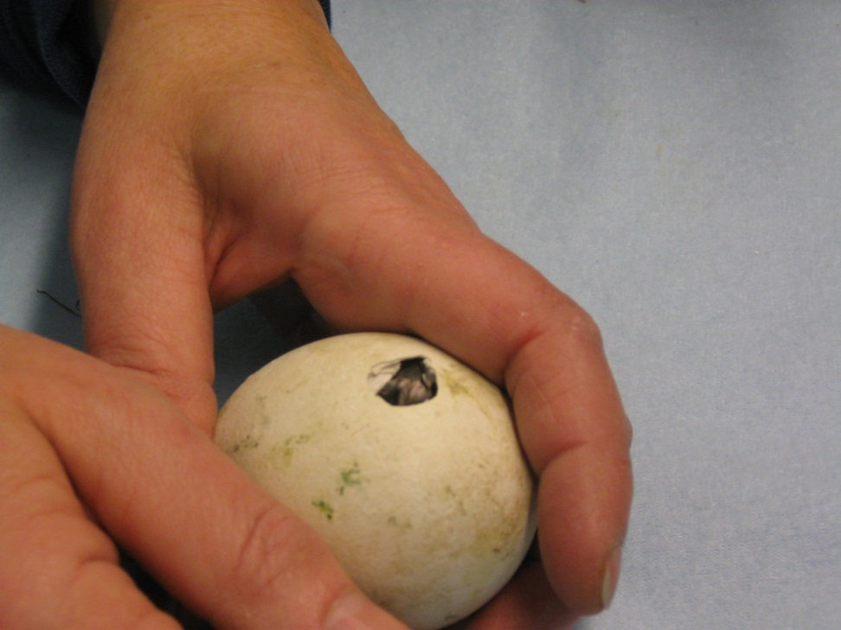
Chick hatching
Based on incubation records, staff should know the approximate pipping and hatch dates
Chick should hatch within 24 hours of an external pip
Staff should be able to identify strong vocalizations vs. distressed ones
Determine if assist hatching is needed

Slide 23
Considerations of Assist Hatching
Chicks vocalizations are strong but there is slow progress in hatching
Egg membrane drying out too quickly
Ideally it is best to not intervene in the hatching process
  Risk of pre-mature umbilical separation

Slide 24
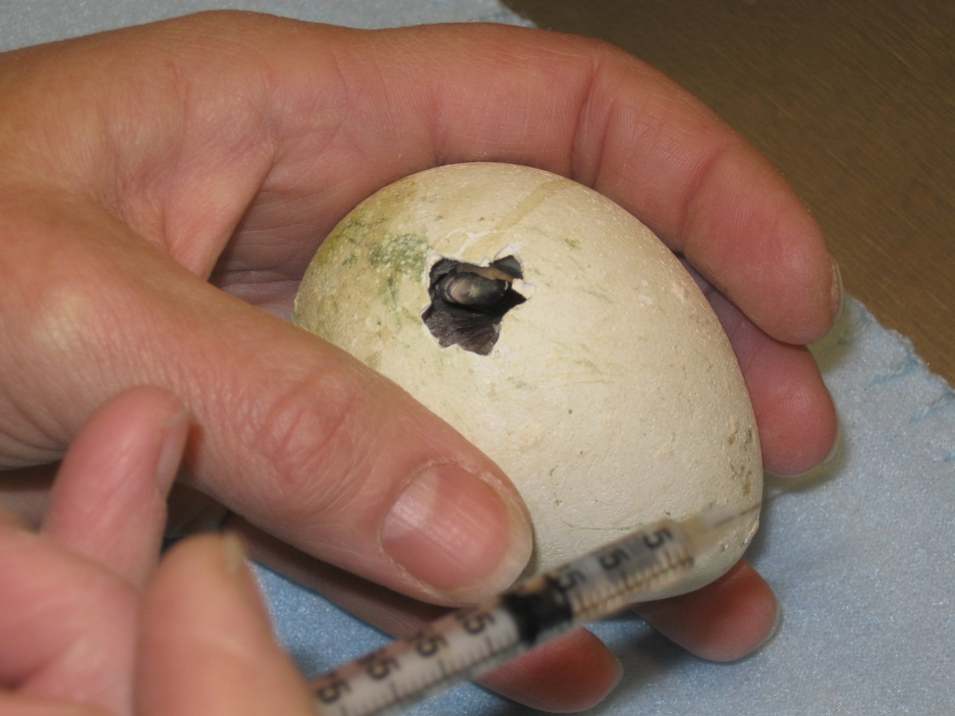
Assist Hatching
Only EXPERIENCED staff should assist hatch an egg
Theory behind assisting is “Giving them a little extra room”
Carefully and slowly moisten membrane with very small amounts of sterile water and peel away shell
  Want to avoid chick aspirating
  Use hemastats to pull egg shell pieces away
  Remove pieces that have completely separated from the membrane

Slide 25
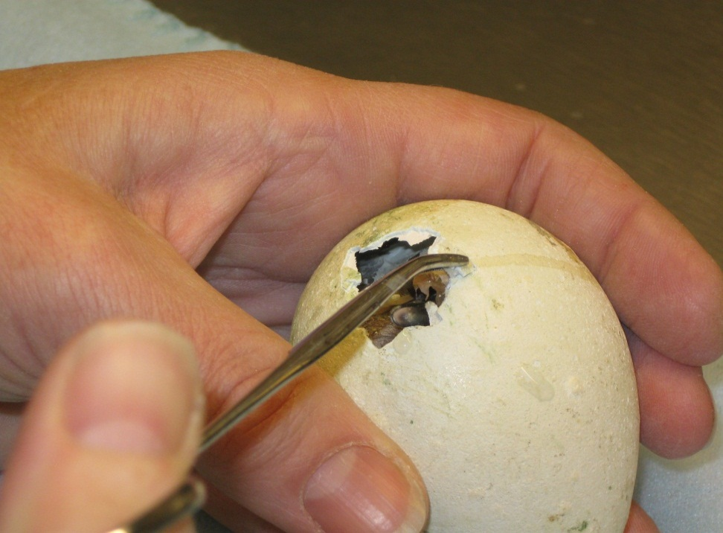
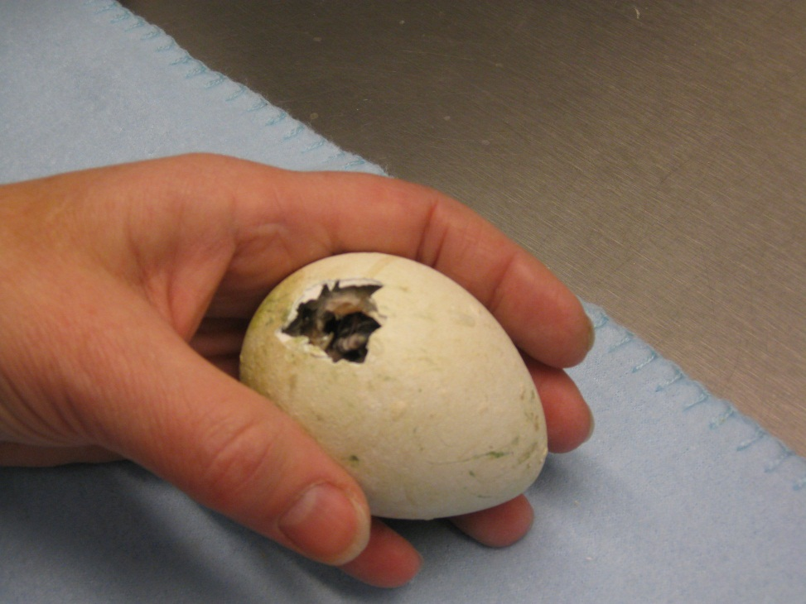
Assist hatching
Hydrate membranes first then remove shell exterior
Giving them a little more
breathing room

Slide 26
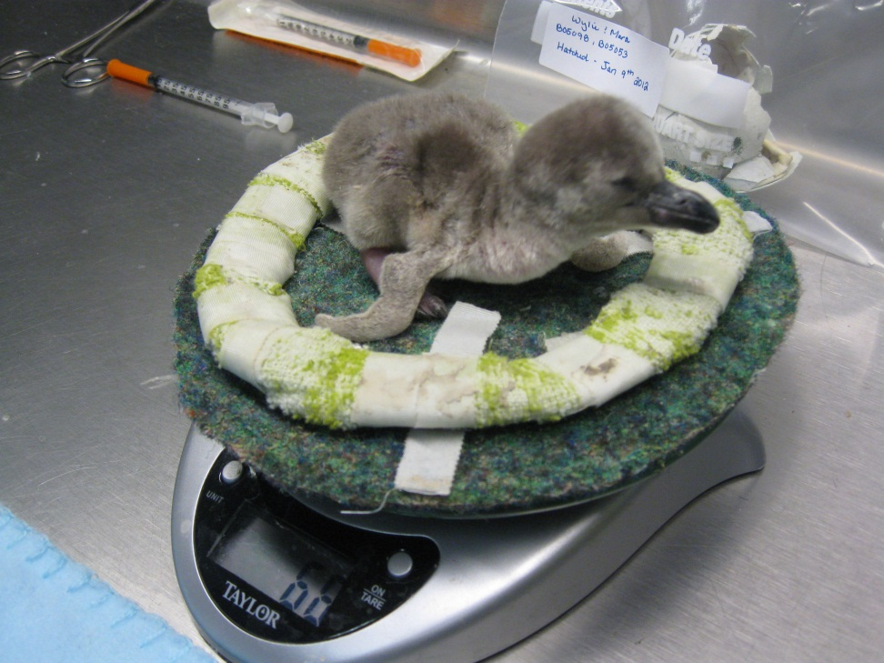
Post hatch priorities
Obtain hatch weight
Collect remaining shell pieces for gender testing
Check umbilicus for proper closing
Check feed response from chick

Slide 27
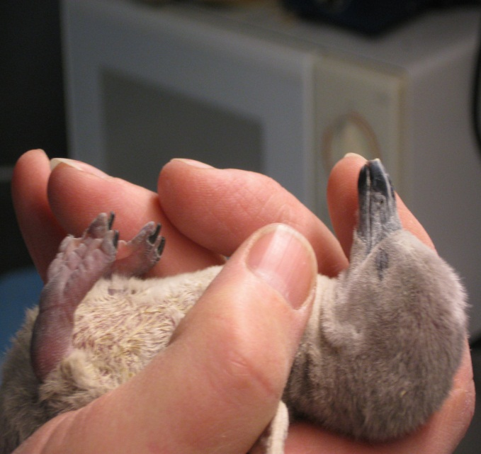
Post hatch priorities
Obtain Hatch weight
Check Umbilicus

Slide 28
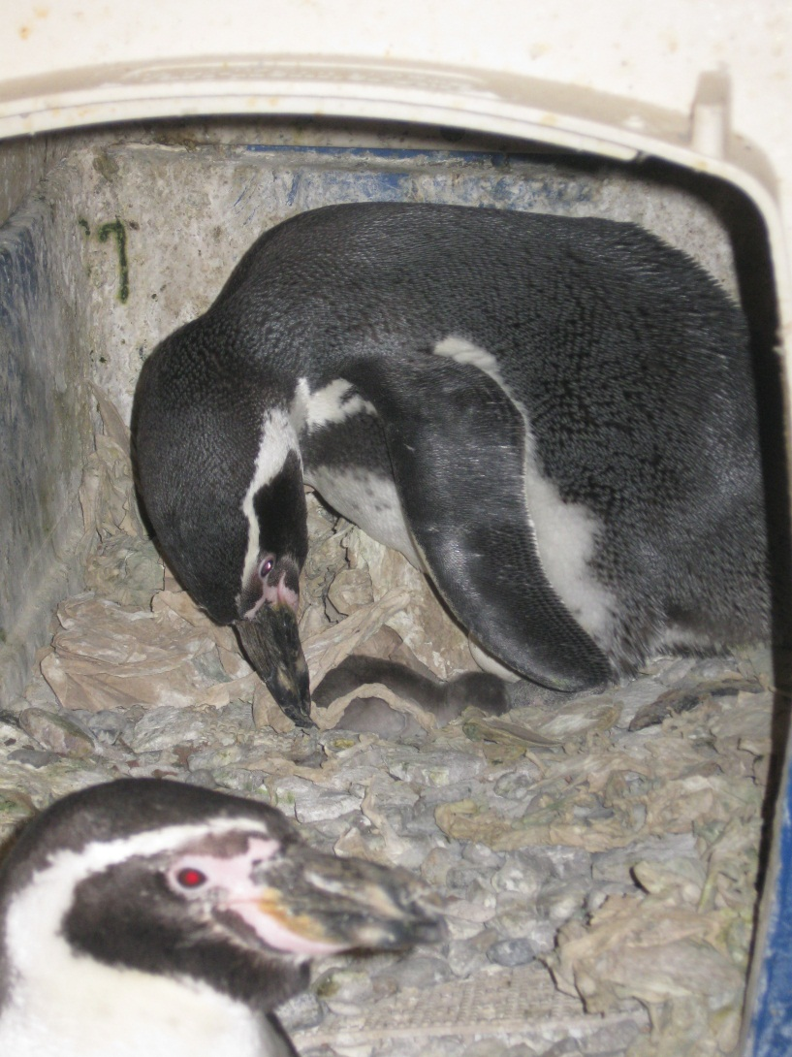
Parent and Foster needs
Increase food offering minimum 3x’s up to 5x’s daily
  If available staff can use alternative fish (silversides) when chicks are smaller
  Parent birds will select smaller fish if they have the opportunity when chicks are young

Slide 29
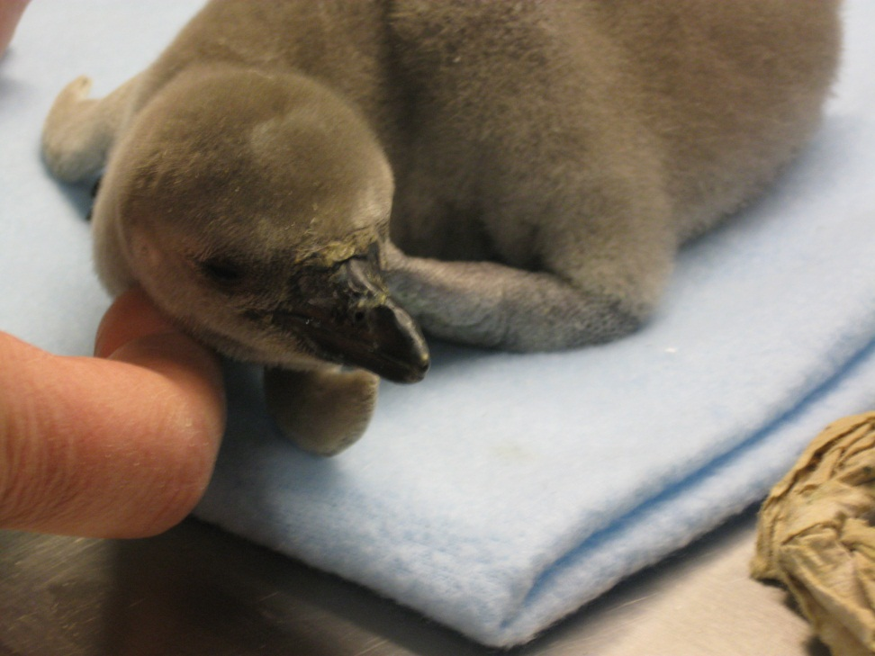
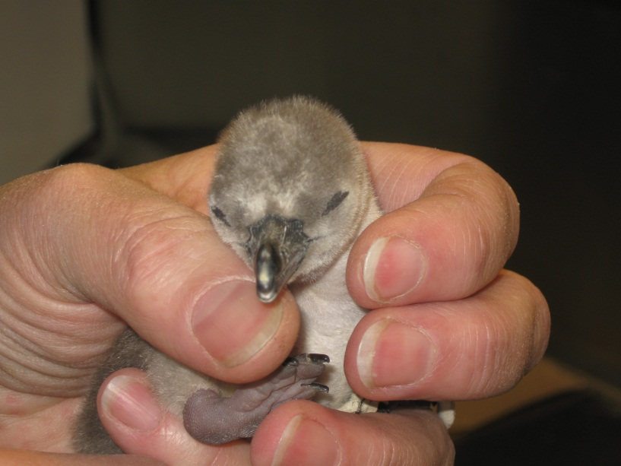
Chick development

Slide 30
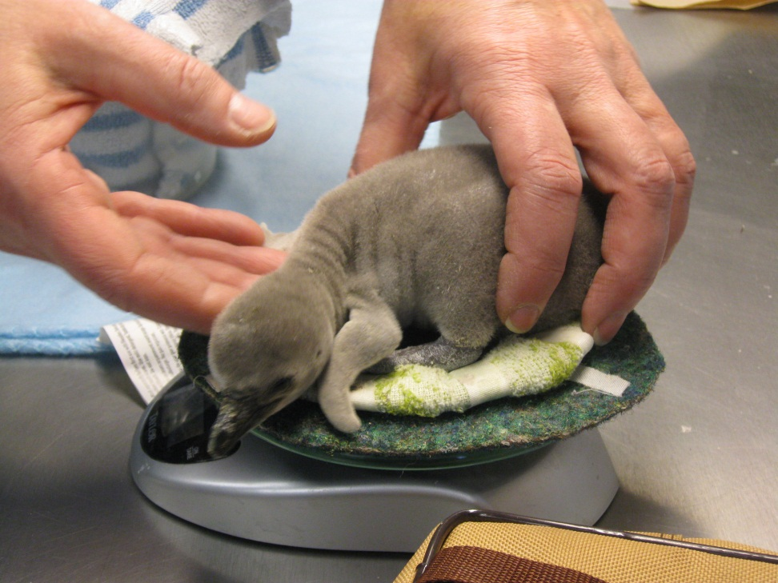
Monitoring weight
If possible staff should obtain daily weight on the chicks for the first 3 weeks
Minimum of bi-weekly weights up through weaning

Slide 31
What to expect
Chicks may begin exploring outside of nest by 4 weeks.
Identify any hazards in regards to chicks when exploring, (ie: access to water)
Monitor parental response when chicks are out
Observe parental response when chicks re-enter the nest
Monitor possibility of earlier than normal weaning

Slide 32
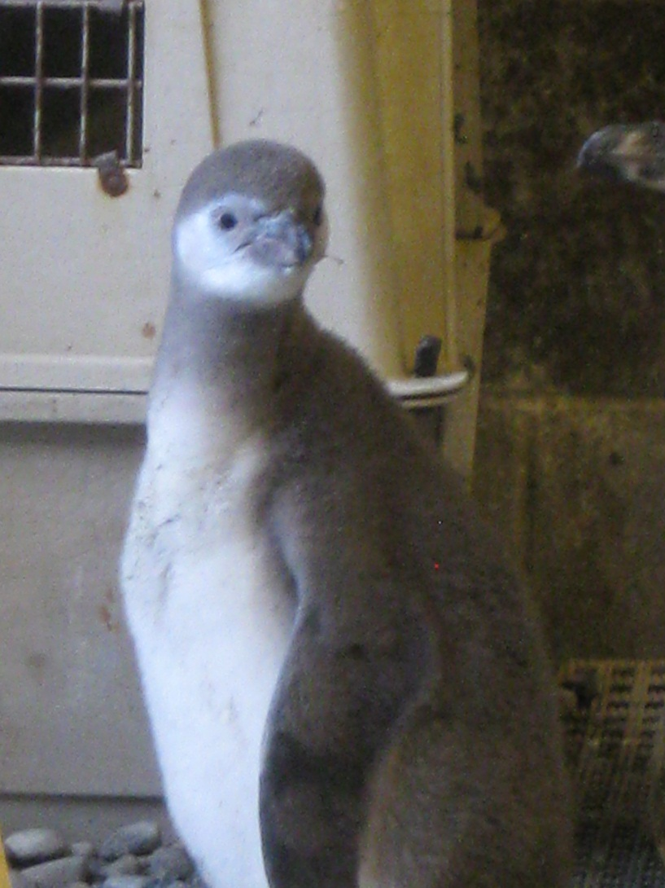
Weaning
Pull as early as 40 days
Signs that indicate to start weaning
  Continuous food solicitations by chick after parents were fed
  Parents pecking at chicks or refusing to allow chicks to return back into nest

Slide 33
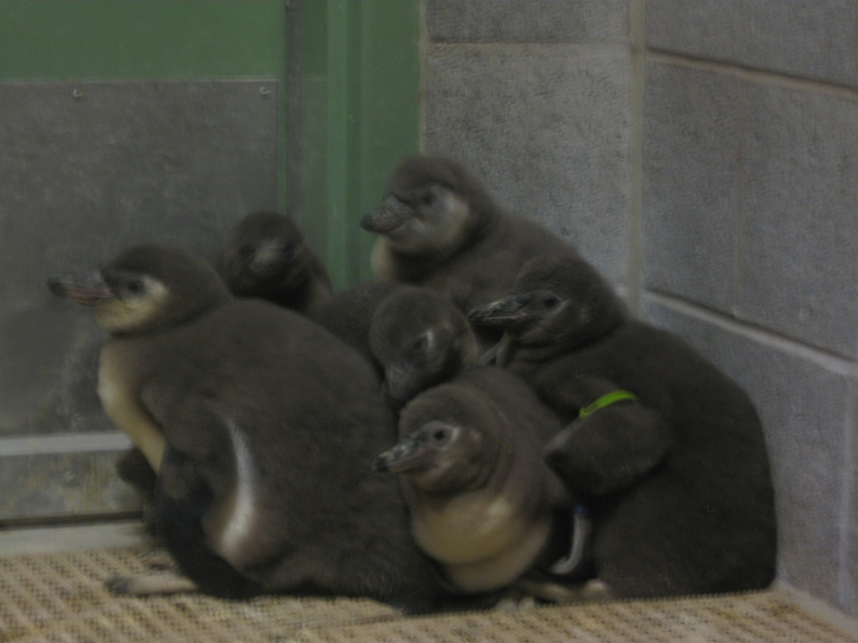
Weaning
Best to wean chicks together if possible
Assist feed until chicks accept fish directly by hand
Habituation to staff
Scale training
Pool lessons

Slide 34
Assist feeding
On average it may take from 3 days to 2 weeks for a chick to readily solicit and accept food by hand (each individual is unique)
Hydrate fish for approximately the first 5 days using 50/50 solution of electrolytes and tap water
Give breaks between each fish for the first few sessions
Chicks that catch on early should be placed on regular schedule ie: 2x’s per day

Slide 35
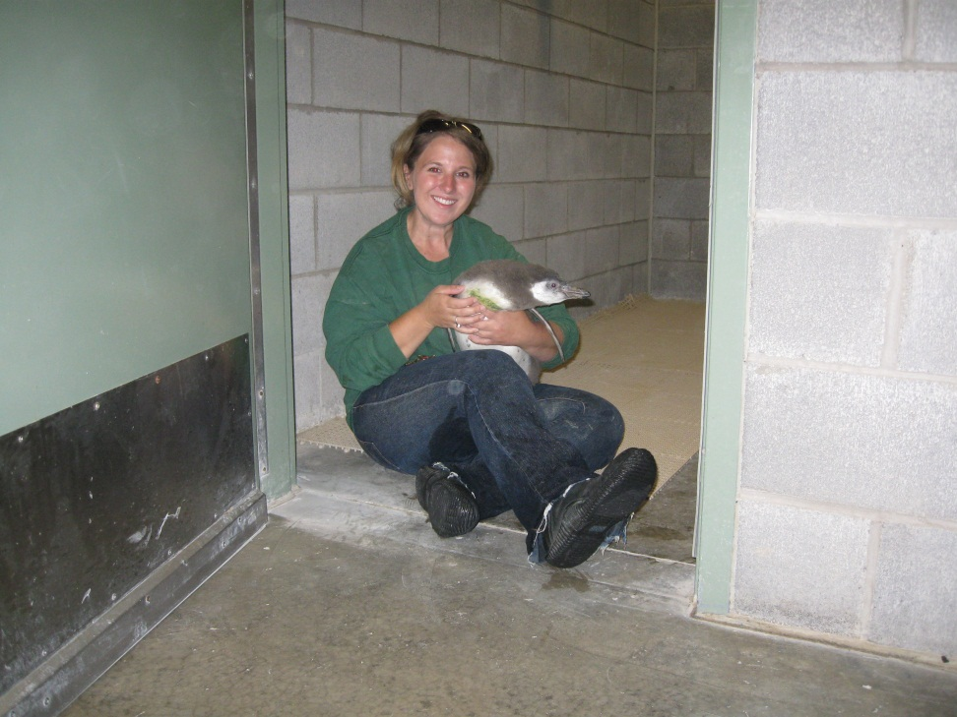
Habituation to handling
Allow chicks to become used to all facets of staff working around them
Handling should incorporate being picked up, desensitizing for various procedures
Identify potential birds that may be especially tractable and can later be used for special events; tours

Slide 36
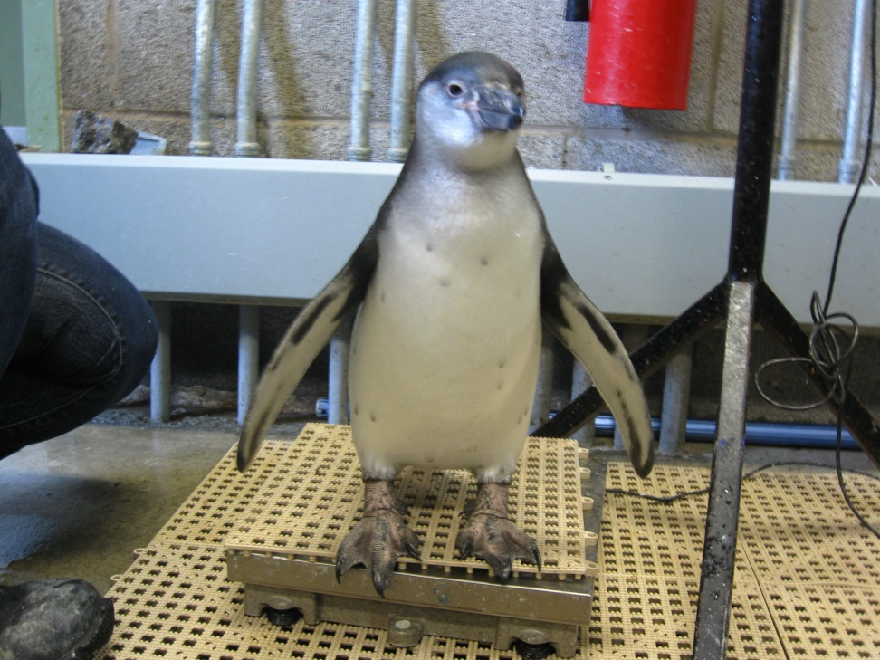
Scale training
Goal: acquire voluntary weights on a regular basis
Become part of the chicks routine of moving from one holding room to another

Slide 37
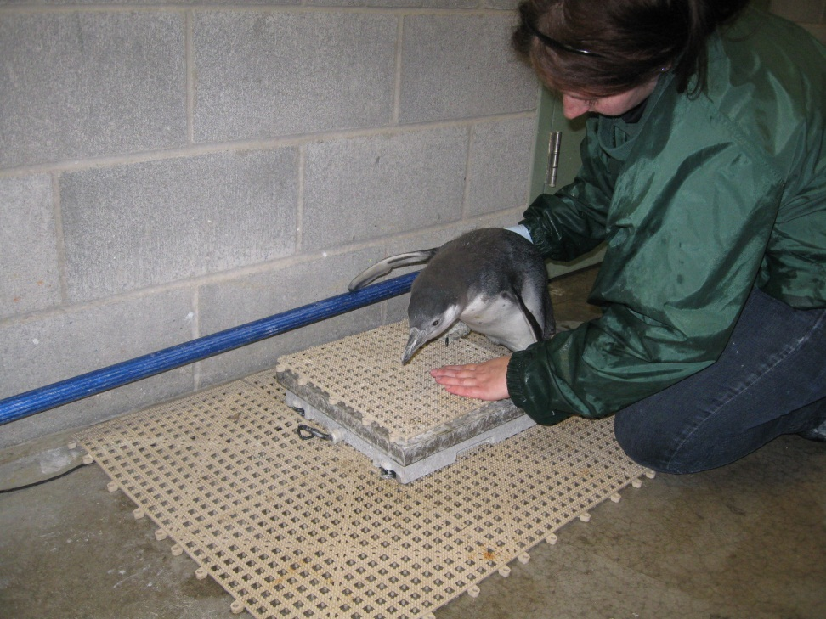
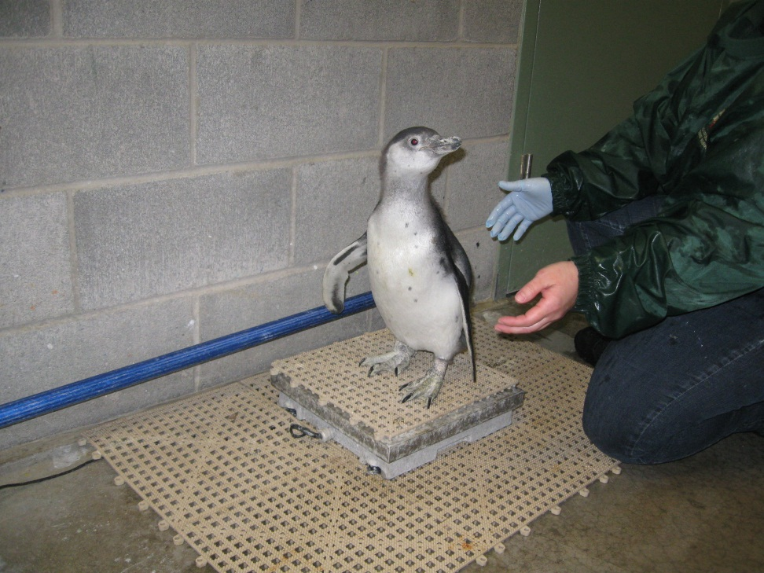
Scale training

Slide 38
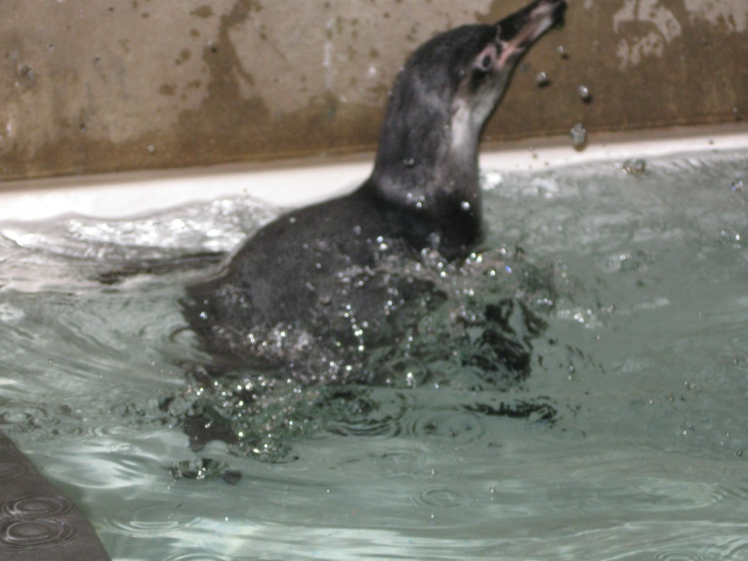
Pool lessons
Acclimating and giving the chicks “practice time” before joining the colony
Monitoring overall safety of getting in & out of pool on their own
Depending on staff; should only work one chick at a time initially
Slowly increase time allowed in practice pools

Slide 39
Integration with colony
All chicks should meet certain standards before joining exhibit colony
Soliciting from keeper(s) and accepting food readily by hand
Safely maneuvering in/out of practice pools
Received all required vaccines

Slide 40
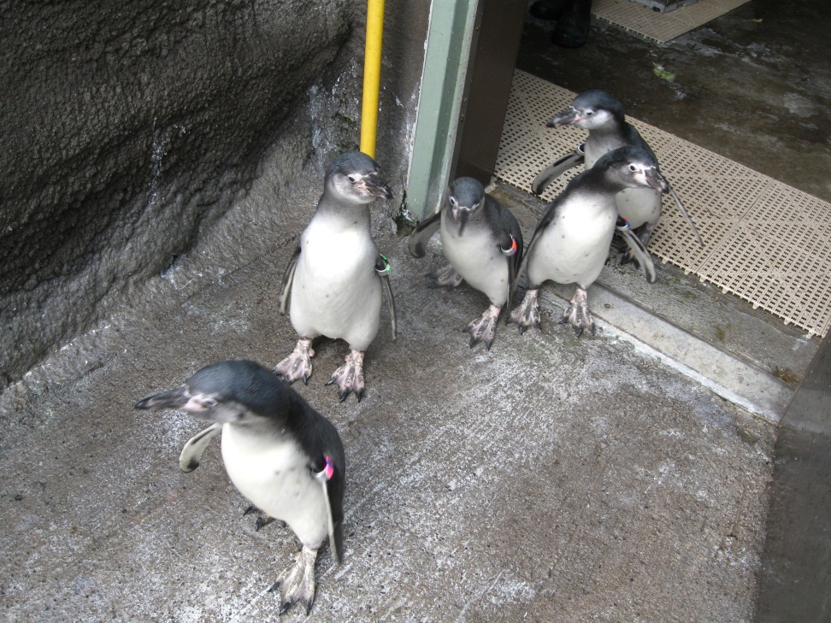
Integration with colony
Staff should discuss best way to introduce chicks out on exhibit
Be willing to adjust your strategy from year to year
Expect some hazing from other birds
May want to temporarily remove problematic birds from the exhibit during initial introduction

Slide 41
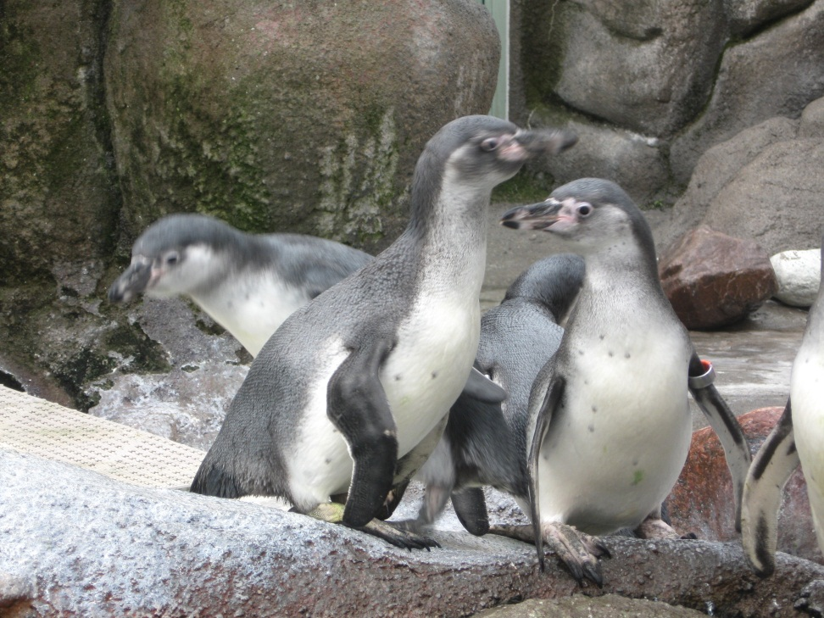
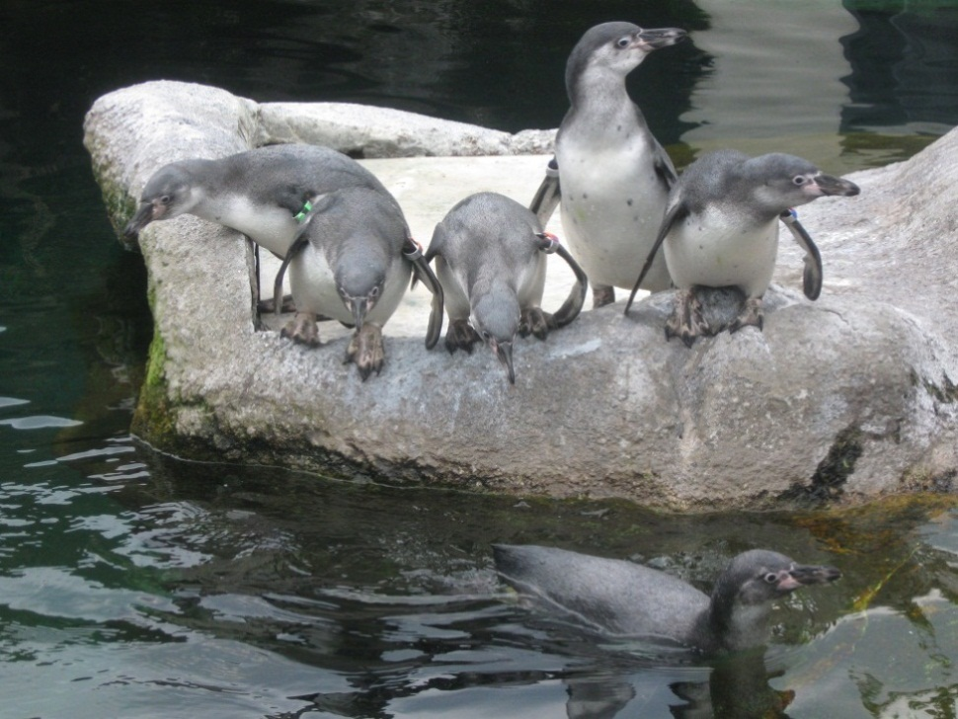
Integration with Colony
Let chicks explore the exhibit on their own before introducing other colony members

Slide 42
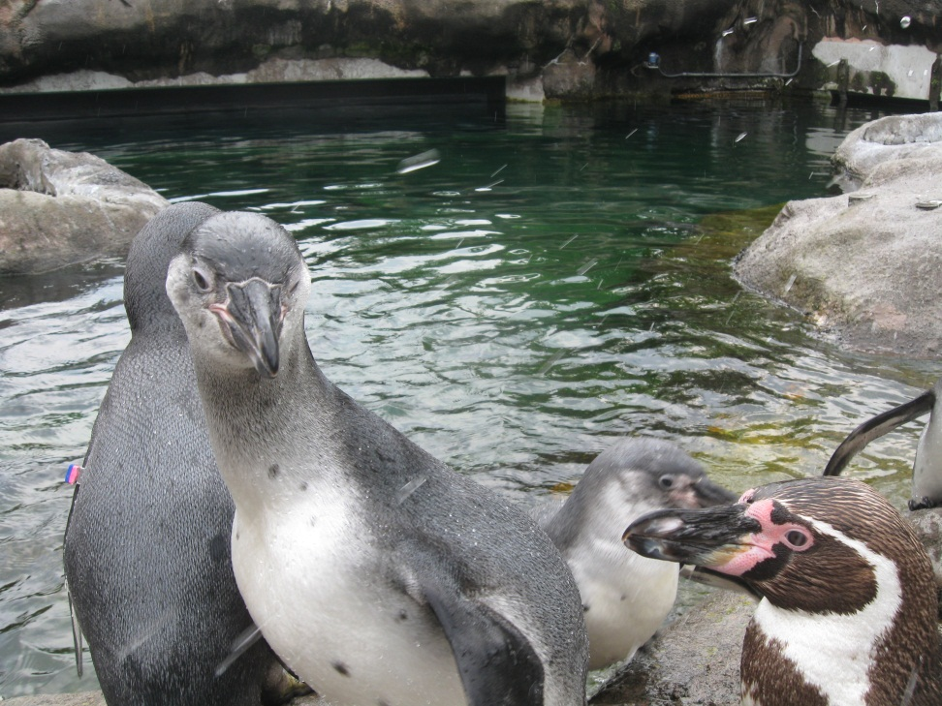
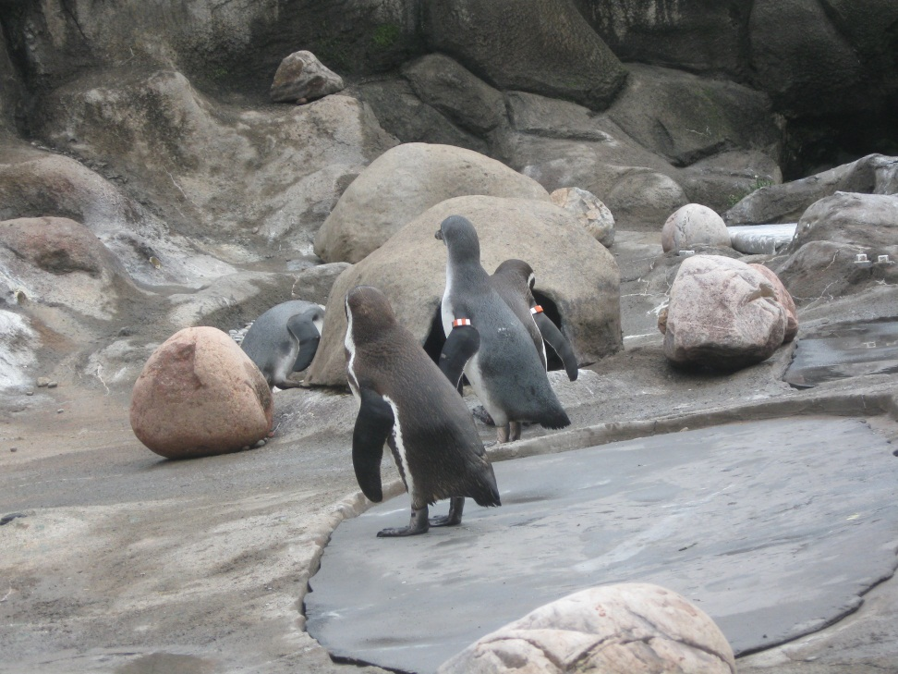
Integration with colony
-Slowly introduce rest of colony

Slide 43
Special cases
Aspergillosis

Slide 44
Hugo’s Story
Hugo hatched on June 26, 2009
At 21 days old he was observed venturing out of the nest with one or both of his parents
Appeared strong and alert, and was steadily gaining weight, indicating that nothing seemed to be abnormal except for early exit of the nest
After 3 days of this exploratory behavior he would have bouts of energy and suddenly fall asleep outside of the nest. Parents were suddenly very skittish (abnormal for them as they are very experienced)

Slide 45
Hugo’s Story
By day 3 symptoms of labored breathing and wheezing appeared
Membranes were very pale
Initial evaluation by veterinary staff indicated a potential heart murmur and/or aspergillosis
Hugo placed on O2 for 45 minutes and immediately placed on a regime of Voriconazole and Clavamox (pending Asper titer results)
Treatment had to be given orally , (supplemented Hugo with whole silversides)

Slide 46
Hugo’s Story
Initial first few days of treatment, Hugo showed signs of improvement
Parents were attentive, responding to his solicitations for food, he did not wander out of crate, breathing was labored at times, (mostly when handled for treatments)
Ultrasound performed a week into treatment, some abnormalities found in air sacs

Slide 47
Treatment –
A roller coaster ride
Upon discovery of respiratory abnormalities, began course of nebulization treatments
Nebulized Hugo in an induction chamber with Amphotericin B
Ideally Veterinary staff want to nebulize for 15 minutes
1st session lasted 6 minutes, stopped when Hugo began severe open mouth breathing
Sessions continued following day and he tolerated the full 15 minute session

Slide 48
Hugo’s treatment
Nebulization treatments increased to B.I.D for 15 minutes each
Supplemented him with extra silversides at treatments; although he was gaining weight he was well below average for chicks of the same age
Other medications continued as well;
  Voriconazole (orally B.I.D in silversides)
  Terbutaline (SQ B.I.D)
  Baytril (orally, S.I.D, very high WBC)

Slide 49
Hugo’ s treatment
From day to day Hugo’s breathing would fluctuate from near normal to very labored.
Some nebulizing treatments were cut short based on how well he tolerated them
Several times he was placed on O2 to relax his respiration intensity
2 weeks into treatment hit a rough patch for 2 days and it seemed that he may not survive
Steady improvements made in the week following

Slide 50
Hugo’s treatment
Week 4 showed significant improvements
Nebulizations discontinued
Terbutaline discontinued
Baytril discontinued
Breathing overall improved, not labored
Was more vocal and increased solicitations for food

Slide 51
Hugo’s Story
Throughout a difficult coarse of treatment staff remained optimistic of Hugo pulling through
Staff were able to keep Hugo with his parents up until weaning
Due to the amount of handling during treatments, he became a very tractable penguin and has remained so since then
Rosamond Gifford Zoo contacted the SSP and has requested that Hugo remain here permanently due to the severity of his case
Hugo has been a healthy bird and has thrived ever since.

Slide 52
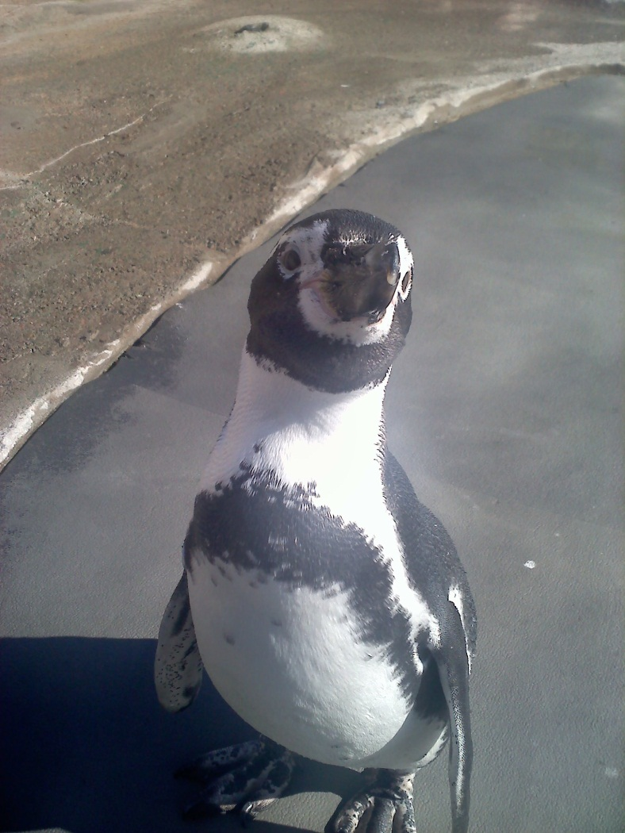
“Baby Huey”

Slide 53
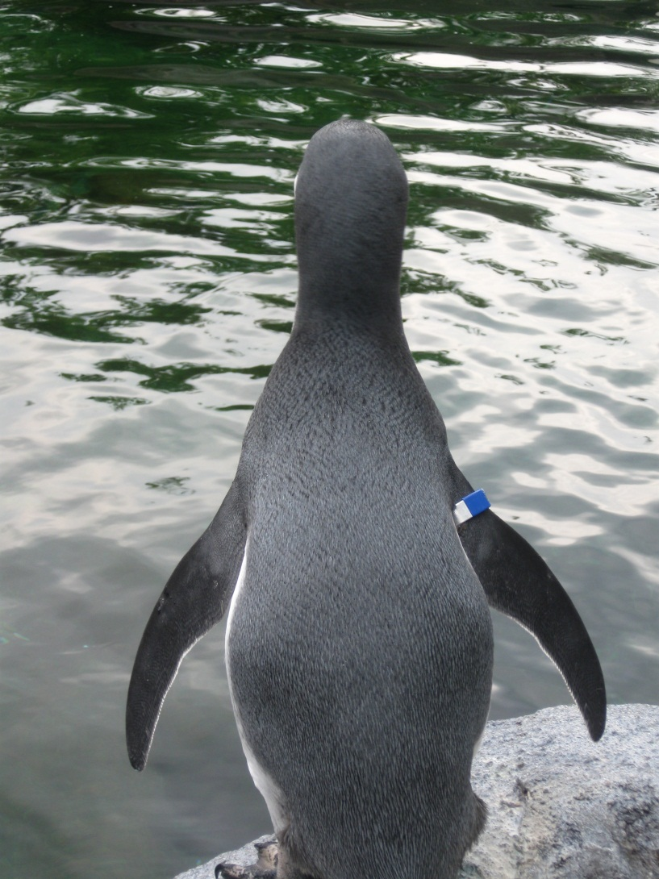
Considerations for your own exhibits
Each year presents new challenges, be willing to try different techniques
Communicate with other zoos and find strategies that work for your program
Work as a cohesive team and be patient

Slide 54

Thanks to the County of Onondaga and the Friends of the Rosamond Gifford Zoo for their support of Penguin coast

